Slide 1


Surgical anatomy of liver and types of liver resection
Dr Nitin Sharma
MBBS(Gold Medalist)
MS, MCh(Gold Medalist),FMAS
Assistant Professor
Department of Pediatric Surgery
Pt JNM Medical College, Raipur

Slide 2
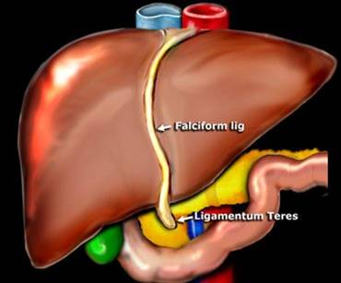
Classical descriptive anatomy:
It is based on external appearance
About how it looks on laparotomy

Slide 3
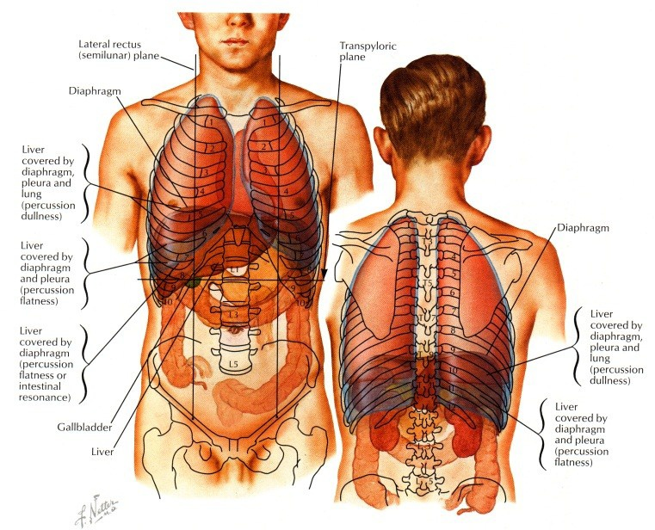
Morphological Anatomy
Position Between 4th intercostal space and costal margin
Extends across midline

Slide 4
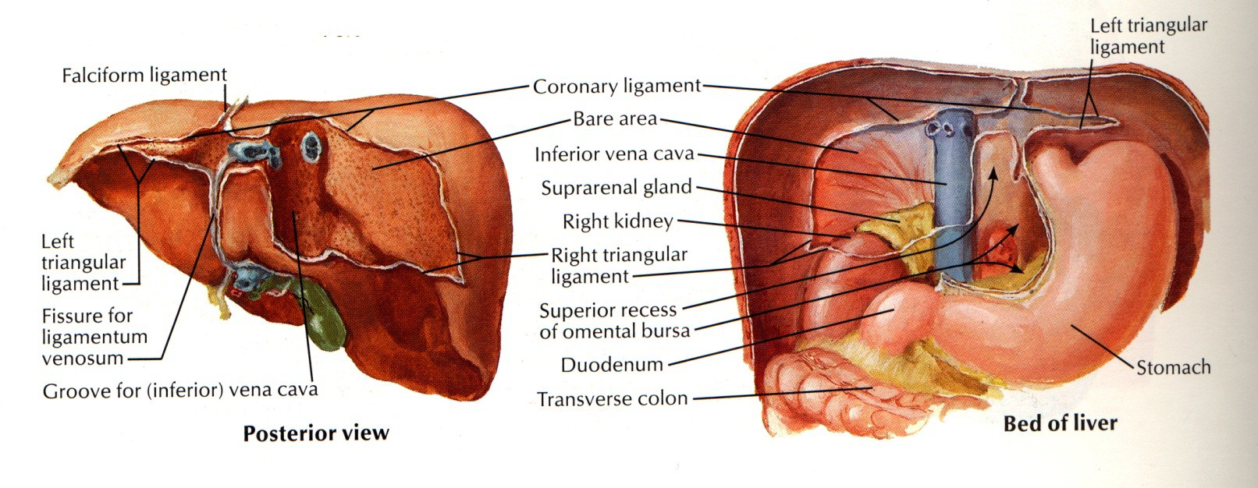
Morphological anatomy
Glisson’s Capsule
Peritoneal Membrane
Peritoneum
Bare patch under diaphragm next to IVC

Slide 5
Morphological anatomy
Ligaments of liver:
  Falciform
  Right and left coronary ligaments
  Gastrohepatic and gastroduodenal ligaments
  Ligamentum venosum
  Ligament of Aranthius

Slide 6
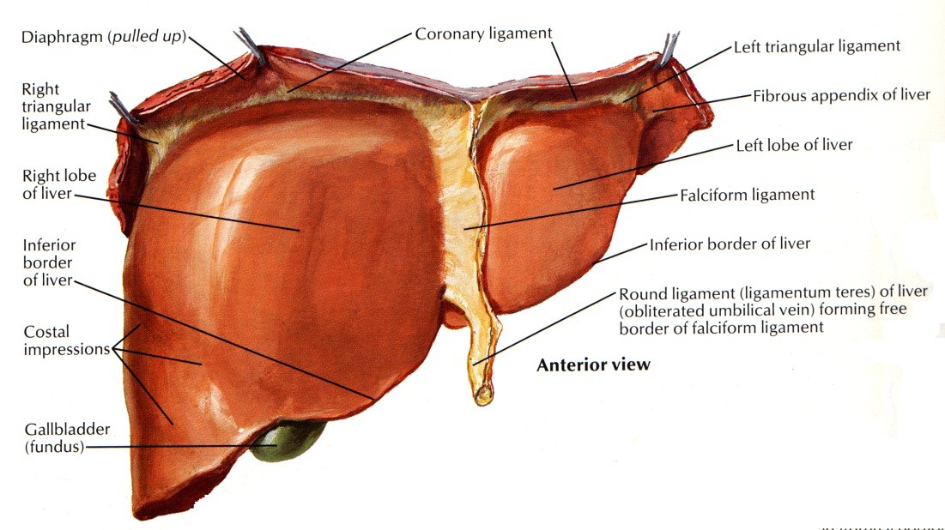
Morphological anatomy(ligaments)
Falciform
  Attaches to anterior abdominal wall from diaphragm to umbilicus
  Includes Ligamentum Teres (round ligament) at inferior border (Former Umbilical Vein)
  May recanalize in portal hypertension, or malignant hematologic disorders

Slide 7
Morphological Anatomy(Coronary)
Right and Left
Connect diaphragm to liver
Lateral aspects become Triangular Ligaments

Slide 8
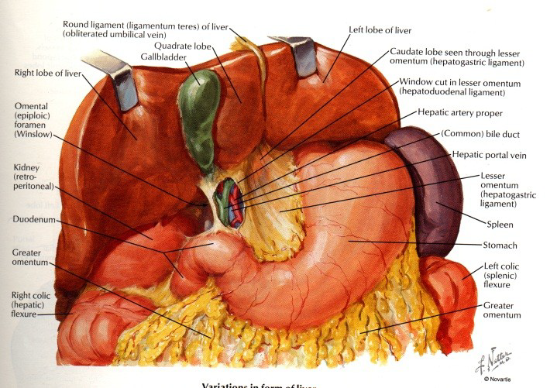
Morphological anatomy(ligaments)
Gastrohepatic
  Anterior layer of lesser omentum
  Continuous with Left Triangular Ligament
Hepatoduodenal
  Anterior border of Foramen of Winslow
  Contains Portal Triad

Slide 9
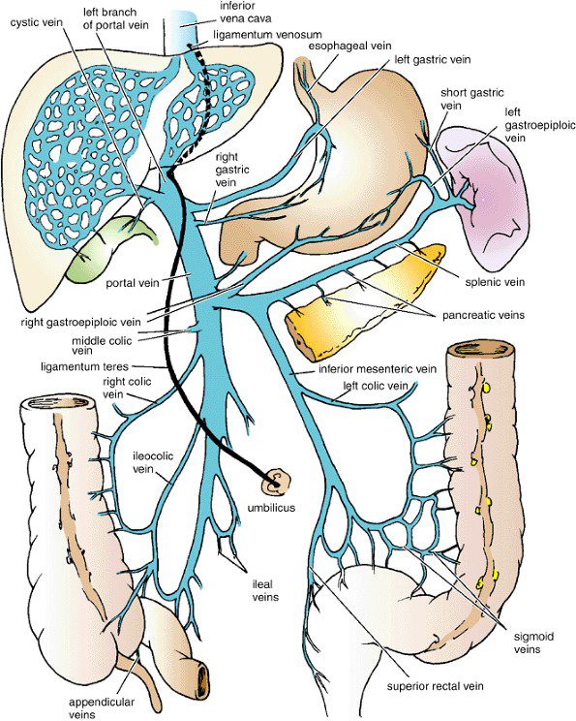
Morphological anatomy(ligaments)
The Ligamentum Venosum
  Fibrous band/Remainant of ductus venosus
Ligament of Aranthius
  Attached to the left branch of the portal vein
  Ascends in a fissure on the visceral surface of the liver to be attached above to the inferior vena cava

Slide 10
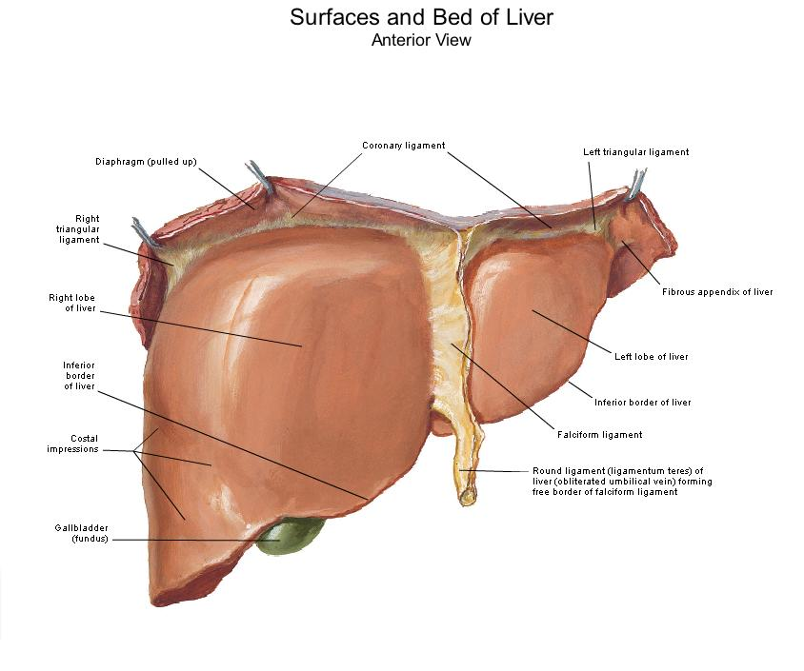
Right & left lobes :
Notes:
Right lobe(Anatomical)
The superior surface is convex under the diaphragm.
The anterior margin is divided by the anterior part of the gallbladder fossa.
The quadrate lobe lies at the
inferior surface anterior to the hilum,
to the right of the umbilical fissure,
and to the left of the gallbladder fossa.
Left Lobe(Anatomical)
The smaller portion of the liver, lies to the left of the falciform and round ligaments and the hilum.

Slide 11
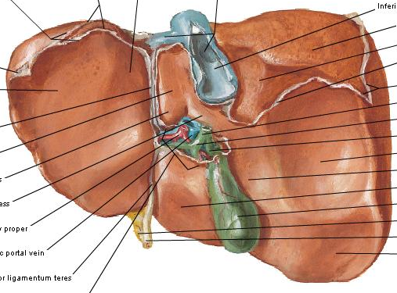
Caudate &quadrate lobes:
Notes:
Caudate Lobe(Anatomical)
It is posterior to the transverse fissure of the hilum,
it is delimited at the left by the ligament of Arentius (ligament venosum), with the insertion of the lesser omentum.
At the right, the caudate lobe has no visible structure that delimited it.
It has been subdivided in a
paracaval portion(encircled the side of the inferior vena cava)
A spigelian lobe.

Slide 12
Functional/Surgical anatomy of the liver

Slide 13
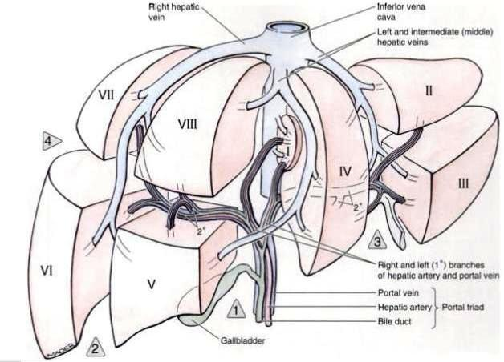
Functional anatomy
Refers to the description of hepatic segmentation that is the real anatomic basis for modern hepatic surgery

Slide 14
Functional anatomy
Cantlie(1898)
McIndoe and Counseller(1927)
Ton That Tung(1939)
Hjörstjö in (1931)
and independently by Couinaud, Goldsmith, and Woodburne(1957)

Slide 15
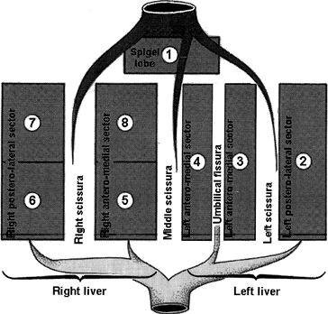
Portal Scissurae
The three scissurae containing the right, middle, and left hepatic veins are called portal scissurae.
Divide the liver into four sectors called portal sectors
Each sector is invested by a glissonian pedicle and its ramifications and is independent of the others

Slide 16
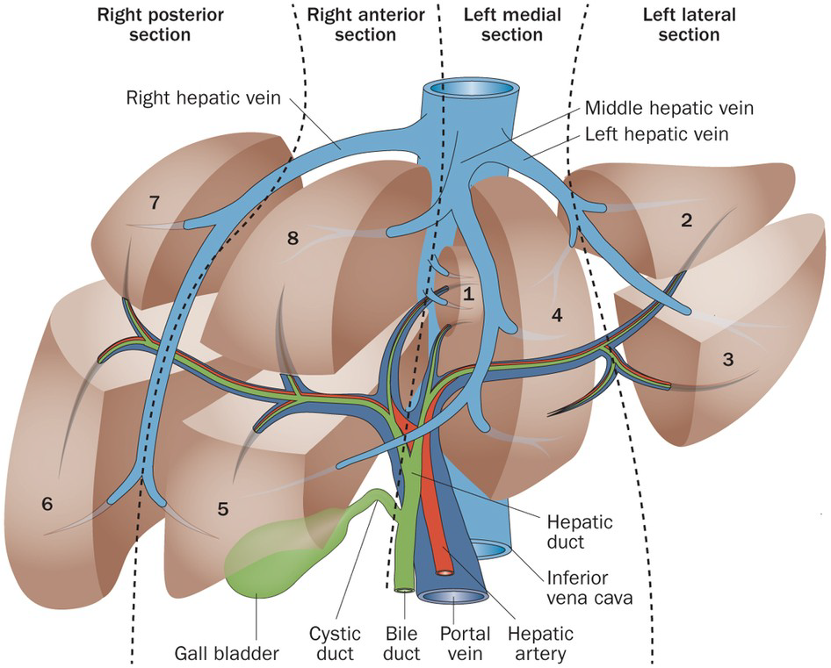
Main Portal scissura
contain the Middle hepatic vein
Begins anteriorly at the middle of the gallbladder bed and posteriorly at the left of the vena cava.
Follows an angle of 75 degrees from the left horizontal plane.

Slide 17
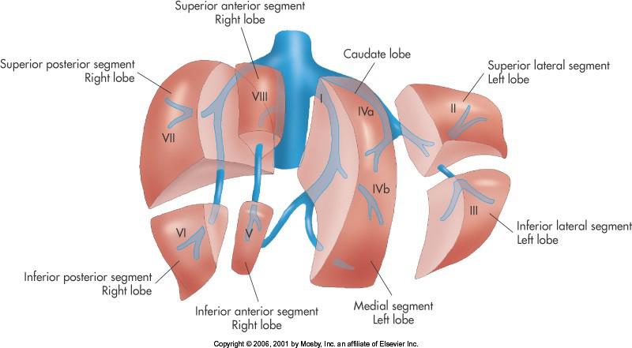
Main Portal scissura
Sometimes called Cantle line separates the liver into two parts—the right and left hemilivers.
Notes:
The right and left livers individualized by the main portal scissura are independent with respect to their portal and arterial vascularization and their biliary drainage.

Slide 18
Right portal scissura
The right portal scissura is inclined approximately 40 degrees to the right.
The exact location of the right portal scissura is not well defined because it has no external landmark

Slide 19
Right portal scissura
Divides the right liver into anteromedial and posterolateral sectors
  clearly seen when the liver undergoes autopsy and is placed on a flat table, where it adopts the bench position

Slide 20
left portal scissura
Divides the left liver into two sectors called anteromedial and posterolateral by Couinaud,
Lies within the left lobe of the liver, posterior to the round ligament, and contains the left hepatic vein.

Slide 21
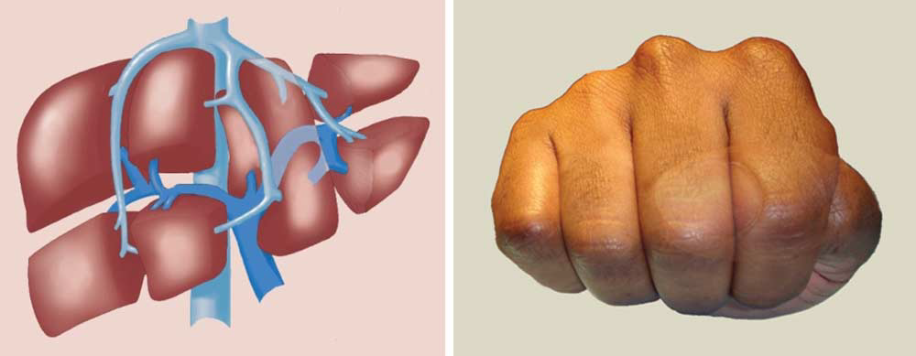

Slide 22
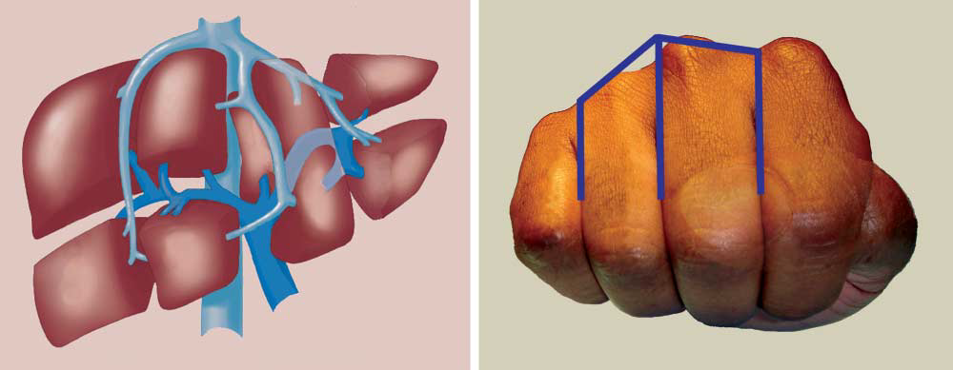
Left Lateral sector
Left Medial sector
Left Lateral sector
Right Anterior sector
Left Medial sector
Right posterior sector
Right Anterior sector
Right posterior sector

Slide 23
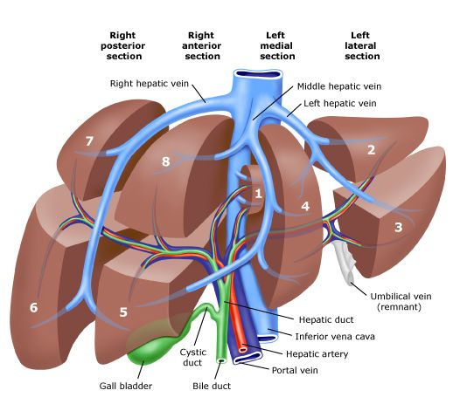
ORGANIZATION OF THE RIGHT LOBE
RIGHT GLISONIAN PEDICLE
ANTERIOR PORTION
POSTERIOR PORTION
ASCENDING BRANCH
ASCENDING BRANCH
DESCENDING BRANCH
DESCENDING BRANCH
SEGMENT 8
SEGMENT 5
SEGMENT 7
SEGMENT 6
Notes:
The right glissonian pedicle divides into anterior and posterior portions.
The right anterior branch arises immediately from the upper right pedicle, running in a frontal plane before dividing into ascending and descending branches for segments 5 (inferior) and 8 (superior)
The posterior branch curves toward the superior convexity of the liver and divides into ascending and descending branches for segments 6 (inferior) and 7 (superior).
The two right sectors are divided into four segments by the right scissura, in which lies the right hepaticvein.
There are no scissurae between segments 5 and 8 and segments 6 and 7

Slide 24
ORGANIZATION OF THE LEFT LOBE
LEFT GLISONIAN PEDICLE
ANTERIOR BRANCH
POSTERIOR BRANCH
LEFT BRANCH
MULTIPLE RIGHT BRANCHES
SEGMENT 3
SEGMENT 4
SEGMENT 2
Notes:
The left glissonian pedicle at the left end of the hilum gives rise to a segmental branch that supplies the posterior part of the left lobe, thereby delimiting segment 2.
This branch curves for a short distance and terminates 1 to 2 cm from the anterior edge of the liver at the recessus of Rex, where the round ligament is joined anteriorly.
The intrahepatic portion of the left glissonian pedicle gives rise to branches that lead to segments 2, 3, and 4.
From the left side, a branch arises for the anterior part of the left lobe, which is segment 3.
On the right side, two or three branches arise for the part of the left liver situated to the right of the umbilical fissure, called segment 4, corresponding to the quadrate lobe in morphologic anatomy.
The portion to the left half of the gallbladder bed is termed segment 4a (inferior), and the tissue above the left pedicle and the caudate (spigelian) lobe is termed segment 4b (superior).
Thus, the inferior left sector comprises segments 3 and 4, and the superior left sector (which is also the posterior part of the morphologic left lobe) forms segment 2.

Slide 25
Organization of Left lobe
Segment 4a(inferior): The portion to the left half of the gallbladder bed
Segment 4b(superior): The tissue above the left pedicle and the caudate (spigelian) lobe

Slide 26
Organization of Left lobe
Inferior left sector= Comprises segments 3 and 4
Superior left sector (which is also the posterior part of the morphologic left lobe= segment 2

Slide 27
Organization of Caudate lobe
Autonomous.
Vasculature is independent of the glissonian division and of the three hepatic veins.
Supplied most of the time by two, three, or four portal branches.
However, the number of portal branches can vary from 1 to 6.
Notes:
segment 1 is autonomous.
Its vasculature is independent of the glissonian division and of the three hepatic veins.
The caudate lobe (i.e., segment 1) is supplied most of the time by two, three, or four portal branches.
However, the number of portal branches can vary from 1 to 6.
The most common origin of the portal branches is the left portal vein (48.6%) but they can come from the right portal vein (22.9%), from the
bifurcation of the portal vein (17%), and from the main portal trunk (11.5%).
The spigelian lobe
is principally supplied by the branch originating from the left portal vein, whereas the paracaval portion is supplied with combinations of branches stemming from different points, especially from the trunk or the bifurcation of the portal vein.

Slide 28
Organization of Caudate lobe
Most common origin of the portal branches is the left portal vein (48.6%) but they can come from the right portal vein (22.9%), from the bifurcation of the portal vein (17%), and from the main portal trunk (11.5%).
The spigelian lobe is principally supplied by the branch originating from the left portal vein,
Paracaval portion is supplied with combinations of branches especially from the trunk or the bifurcation of the portal vein.
Notes:
segment 1 is autonomous.
Its vasculature is independent of the glissonian division and of the three hepatic veins.
The caudate lobe (i.e., segment 1) is supplied most of the time by two, three, or four portal branches.
However, the number of portal branches can vary from 1 to 6.
The most common origin of the portal branches is the left portal vein (48.6%) but they can come from the right portal vein (22.9%), from the
bifurcation of the portal vein (17%), and from the main portal trunk (11.5%).
The spigelian lobe
is principally supplied by the branch originating from the left portal vein, whereas the paracaval portion is supplied with combinations of branches stemming from different points, especially from the trunk or the bifurcation of the portal vein.

Slide 29
Comparison between classical anatomy & modern functional segmentation of the liver…

Slide 31
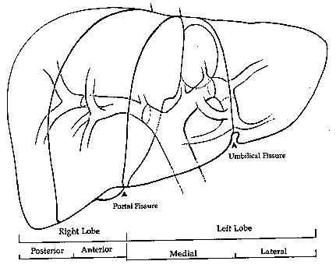
Lobar Anatomy
(American System)
Right and Left Lobe determined by Cantlie’s Line (portal fissure)
– Gallbladder Fossa to IVC

Slide 32
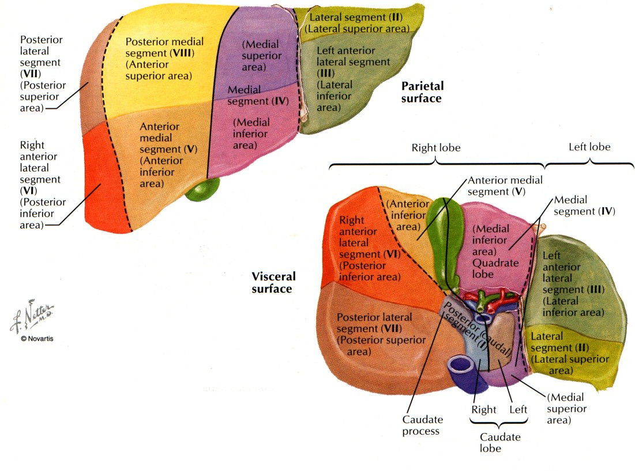
Segmental Anatomy
(Couinaud System)
Caudate Lobe= Segment I
Left Lobe= Segments II – IV
Right Lobe=Segments V-VIII

Slide 33
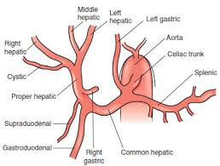
Blood supply of the liver
Proper hepatic artery
The right and left hepatic arteries enter the porta hepatis.
The right hepatic artery usually gives off the cystic artery, which runs to the neck of the gallbladder.

Slide 34
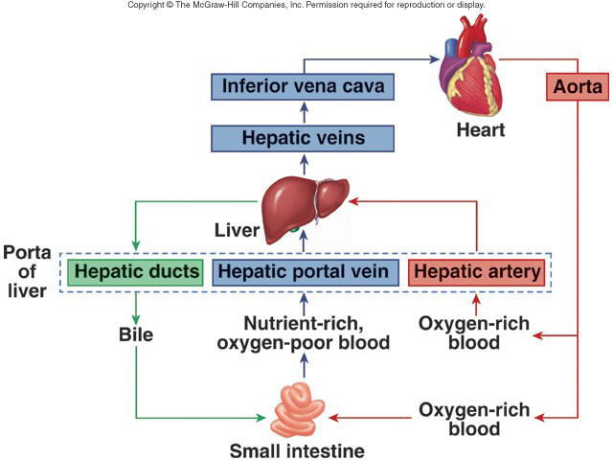
Blood supply of the liver

Slide 35
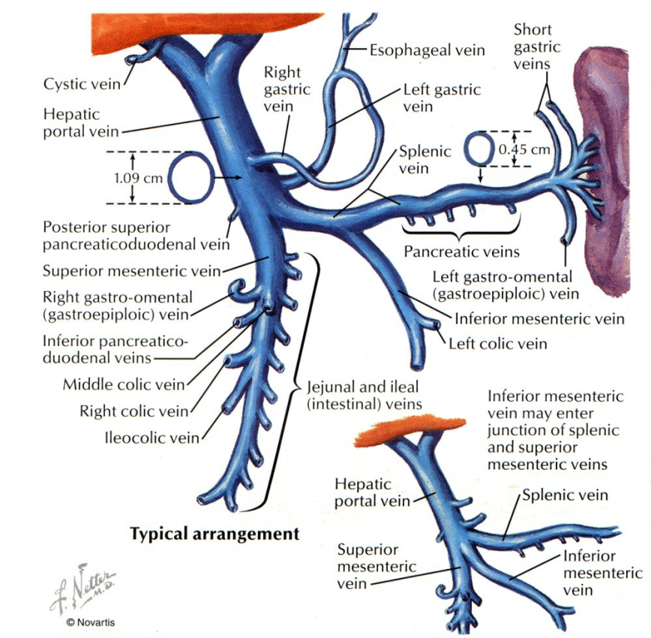
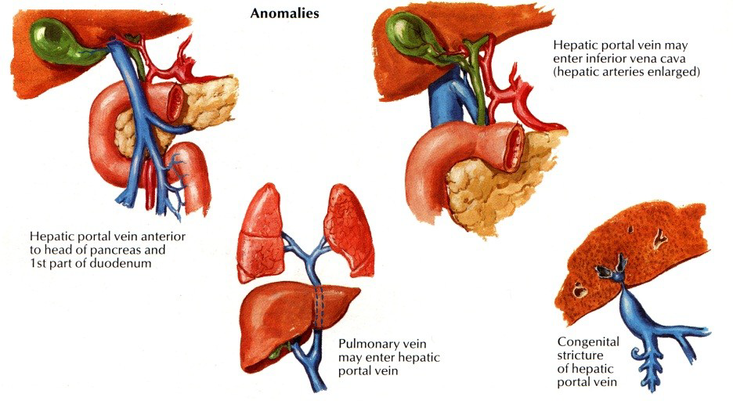
Portal Vein
75% of hepatic blood flow
5-8cm length
4-5mm Hg

Slide 36
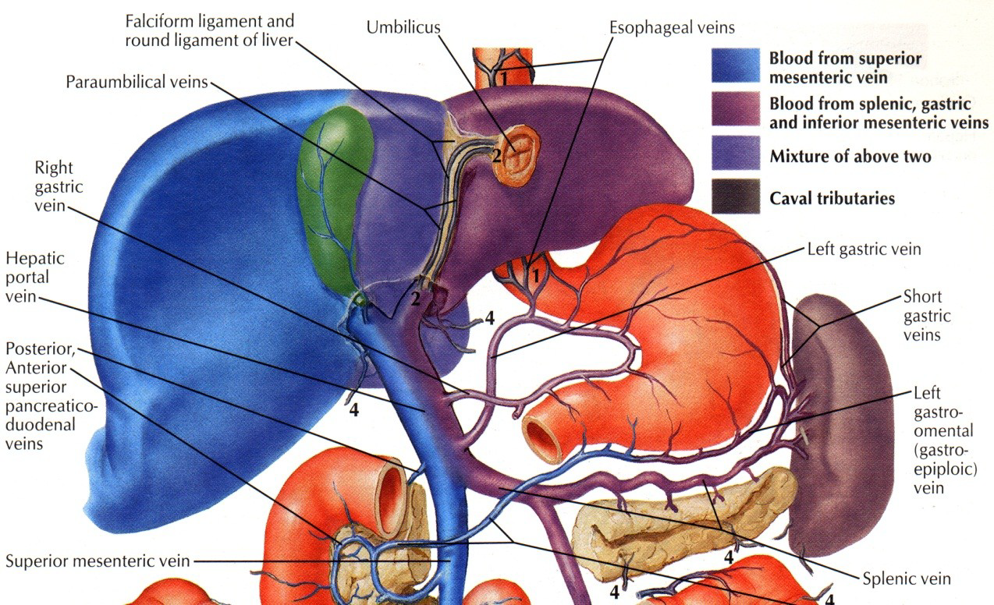
Portal vein
Laminar Blood flow
– Affects distribution of amebic abscesses and
tumor metastases

Slide 37
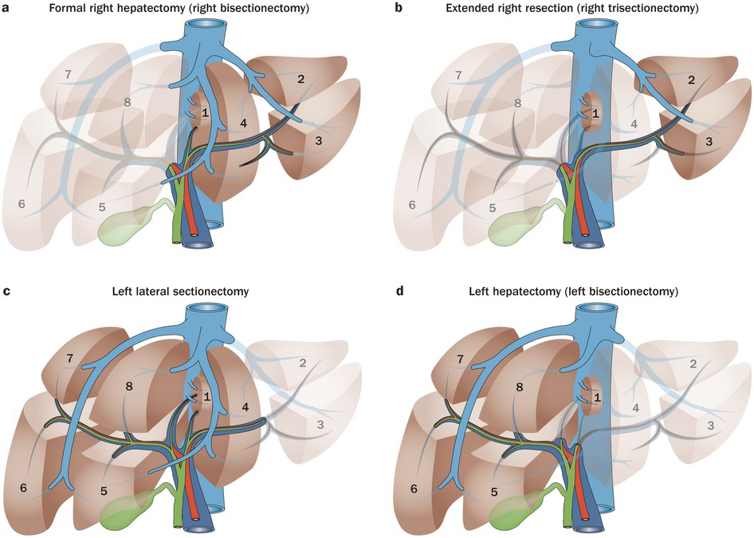
TYPES OF LIVER RESECTIONS

Slide 38
LIVER RESECTION
ANATOMIC LIVER RESECTION
NON ANATOMIC LIVER RESECTION

Slide 39
LIVER RESECTION
ACCORDING TO SEGMENT
ACCORDING TO SURGICAL TECHNIQUE

Slide 40
HEPATECTOMY ACCORDING TO THE SEGMENTS REMOVED
HEPATECTOMY
SUPEREXTENDED
EXTENDED
LIMITED
RT TO 1/4
6 SEG
UPTO 2 SEG
LEFT TO 1/5/8
RT TO 1&4
MAJOR
BISEG
SUBSEG
SECT
RIGHT
(4 SEG)
LEFT
(4 SEG)
TRISEG
(3 SEG)
Eg 4,5,6
Notes:
Superextended hepatectomies (Resection of six segments)
(Right hepatectomy extended to segments 1 and 4)
Extended hepatectomies are
Right hepatectomies extended to segment 1 or 4 (five segments), or
Left hepatectomies extended to segments 1, 5, or 8 (four segments).
Major hepatectomies
Right hepatectomy (four segments),
Left hepatectomy, and
Trisegmentectomy (e.g., of segments 4, 5, and 6) (three segments)
Limited hepatectomies involve up to two segments and include
Left lobectomy,
Bisegmentectomy (segmentectomy 6, 7),
Right posterior sectoriectomy,
Segmentectomy, and
Subsegmentectomy (e.g., anterior segmentectomy 4 or resection of the quadrate lobe)

Slide 41
HEPATECTOMY ACCORDING TO THE SURGICAL TECHNIQUE
PRELIMINARY VASCULAR SECTION
HEPATECTOMY
PRIMARY PARENCHYMAL TRANSECTION
SELECTIVE CLAMPING
TOTAL VASCULAR EXCLUSION
PEDICULAR CLAMPING
SUPRA HILAR CLAMPING
INTRAHEPATIC PORTAL CONTROL

Slide 42
HEPATECTOMY ACCORDING TO THE SURGICAL TECHNIQUE
HEPATECTOMY
PRELIMINARY VASCULAR SECTION
LORTAT-JACOB ET AL
LIGATING AND DIVIDING THE GLISSONIAN PEDICLE (VEIN AND ARTERY)
LIGATION AND SECTION OF THE RIGHT HEPATIC VEIN BEFORE TRANSECTING THE PARENCHYMA

Slide 43
HEPATECTOMY ACCORDING TO THE SURGICAL TECHNIQUE
HEPATECTOMY
PRIMARY PARENCHYMAL TRANSECTION
TON THAT TUNG IN 1965
INCISION OF THE PARENCHYMA ALONG THE LINE OF THE SCISSURA.
HILAR ELEMENTS ARE APPROACHED AND LIGATED FROM WITHIN THE LIVER DURING THE PARENCHYMAL TRANSECTION.
SECTION OF THE HEPATIC VEIN IS PERFORMED AT THE END OF THE PROCEDURE, ALSO INSIDE THE LIVER
Notes:
Hepatectomy by Primary Parenchymal Transection
Described by Ton That Tung in 1965, is to begin with an incision of the parenchyma along the line of the scissura.
The hilar elements are approached and ligated from within the liver during the parenchymal transection. Section of the hepatic vein is performed at the end of the procedure, also inside the liver.

Slide 44
HEPATECTOMY ACCORDING TO THE SURGICAL TECHNIQUE
HEPATECTOMY
PRIMARY PARENCHYMAL TRANSECTION
ADVANTAGES
EXCISES AN AMOUNT OF LIVER PARENCHYMA À LA DEMANDE, ACCORDING TO THE NATURE AND THE LOCATION OF THE LESION
LIGATION OF THE VESSELS IS NOT HAMPERED BY ANATOMIC ABNORMALITIES
Notes:
Hepatectomy by Primary Parenchymal Transection
Described by Ton That Tung in 1965, is to begin with an incision of the parenchyma along the line of the scissura.
The hilar elements are approached and ligated from within the liver during the parenchymal transection. Section of the hepatic vein is performed at the end of the procedure, also inside the liver.
Ligation of the vessels is not hampered by anatomic abnormalities

Slide 45
HEPATECTOMY ACCORDING TO THE SURGICAL TECHNIQUE
HEPATECTOMY
PRIMARY PARENCHYMAL TRANSECTION
DISADVANTAGES
CONSIDERABLE INTRAOPERATIVE BLEEDING
NECESSARY TO PERFORM A RAPID SURGICAL PROCEDURE
Notes:
Hepatectomy by Primary Parenchymal Transection
Described by Ton That Tung in 1965, is to begin with an incision of the parenchyma along the line of the scissura.
The hilar elements are approached and ligated from within the liver during the parenchymal transection. Section of the hepatic vein is performed at the end of the procedure, also inside the liver.
Ligation of the vessels is not hampered by anatomic abnormalities

Slide 46
HEPATECTOMY ACCORDING TO THE SURGICAL TECHNIQUE
HEPATECTOMY
SELECTIVE CLAMPING
BISMUITH ET AL
BEGIN WITH A HILAR DISSECTION, TO GAIN SEPARATE CONTROL OF THE ARTERIAL AND PORTAL ELEMENTS OF THE PEDICLE AND TO CLAMP THESE ELEMENTS WITHOUT LIGATION
RIGHT SIDE OF THE RETROHEPATIC INFERIOR VENA CAVA IS FREED WITHOUT ATTEMPTING TO DISSECT THE VENA CAVA OR THE RIGHT HEPATIC VEIN
LIVER IS OPENED ALONG THE LINE OF THE MAIN PORTAL SCISSURA, AND THE GLISSONIAN ELEMENTS ARE LOCATED AND DIVIDED THROUGH A SUPERIOR APPROACH
Notes:
Hepatectomy by Primary Parenchymal Transection
Described by Ton That Tung in 1965, is to begin with an incision of the parenchyma along the line of the scissura.
The hilar elements are approached and ligated from within the liver during the parenchymal transection. Section of the hepatic vein is performed at the end of the procedure, also inside the liver.

Slide 47
HEPATECTOMY ACCORDING TO THE SURGICAL TECHNIQUE
HEPATECTOMY
SELECTIVE CLAMPING
PRELIMINARY VASCULAR SECTION
PRIMARY PARENCHYMAL TRANSECTION
Notes:
Hepatectomy by Primary Parenchymal Transection
Described by Ton That Tung in 1965, is to begin with an incision of the parenchyma along the line of the scissura.
The hilar elements are approached and ligated from within the liver during the parenchymal transection. Section of the hepatic vein is performed at the end of the procedure, also inside the liver.

Slide 48
HEPATECTOMY ACCORDING TO THE SURGICAL TECHNIQUE
HEPATECTOMY
TOTAL VASCULAR EXCLUSION
HEANEY AND JACOBSON IN 1975
LIVER FIRST HAS TO BE FULLY MOBILIZED AND THE RIGHT ADRENAL VEIN LIGATED
TOTAL VASCULAR EXCLUSION IS ACHIEVED BY SIMULTANEOUS CLAMPING OF THE HEPATIC PEDICLE AND THE VENACAVA BELOW AND ABOVE THE LIVER

Slide 49
HEPATECTOMY ACCORDING TO THE SURGICAL TECHNIQUE
HEPATECTOMY
TOTAL VASCULAR EXCLUSION
DISADVANTAGES
ANATOMIC MARGINS ARE NOT VISIBLE
ONLY THE MAIN SCISSURAE ARE EASY TO LOCATE
ANY INJURY TO THE HEPATIC VEINS OR RETROHEPATIC VENA CAVA CAN GO UNNOTICED
Notes:
Hepatectomy with Total Vascular Exclusion
The main disadvantage especially for extended hepatectomies
anatomic margins are not visible.
Only the main scissurae are easy to locate.
Any injury to the hepatic veins or retrohepatic vena cava can go unnoticed until liver perfusion is re-established.

Slide 50
HEPATECTOMY ACCORDING TO THE SURGICAL TECHNIQUE
HEPATECTOMY
PEDICLE CLAMPING
PRINGLE 1908
INTERRUPTS ALL INFLOW TO THE LIVER PARENCHYMA FROM THE PORTAL VEIN AND HEPATIC ARTERY BUT LEAVES INTACT THE OUTFLOW FROM THE HEPATIC VEINS.
IT IS USEFUL IN ALL TYPES OF HEPATECTOMY, BUT THE ANATOMIC MARGINS ARE NOT VISIBLE.
Notes:
Hepatectomy by Pedicular Clamping
Pringle, in 1908, was the first to describe en bloc clamping of the glissonian pedicle to control hepatic bleeding
This approach interrupts all inflow to the liver parenchyma from the portal vein and hepatic artery but leaves intact the outflow from the hepatic veins. It is useful in all types of hepatectomy, but the anatomic margins are not visible.

Slide 51
HEPATECTOMY ACCORDING TO THE SURGICAL TECHNIQUE
HEPATECTOMY
SUPRAHILAR CLAMPING
SUPERSELECTIVE CLAMPING AT THE SUPRAHILAR LEVEL AFTER DISSECTING THE HILAR PLATE AND EXPOSING THE SECTORIAL BRANCHES OF THE GLISSONIAN PEDICLE
ANTERIOR RIGHT SECTORIAL PORTAL BRANCH IS THE EASIEST TO CONTROL BECAUSE THE SECTORIAL DEVASCULARIZATION IS APPARENT ON THE LIVER SURFACE, WHICH GREATLY FACILITATES RIGHT ANTERIOR AND RIGHT POSTERIOR BISEGMENTECTOMIES
Notes:
Hepatectomy by Suprahilar Clamping
allows superselective clamping at the suprahilar level after dissecting the hilar plate and exposing the sectorial branches of the glissonian pedicle
The anterior right sectorial portal branch is the easiest to control because the sectorial devascularization is apparent on the liver surface, which greatly facilitates right anterior and right posterior bisegmentectomies.

Slide 52
HEPATECTOMY ACCORDING TO THE SURGICAL TECHNIQUE
HEPATECTOMY
INTRAHEPATIC PORTAL CONTROL
ESPECIALLY USEFUL FOR ANATOMIC SEGMENTECTOMY OR SUBSEGMENTECTOMY
OCCLUSION OF THE PORTAL BRANCH TO THE SEGMENT TO BE RESECTED CAN BE ACHIEVED BY TRANSHEPATIC BALLOON CATHETER PLACEMENT
IT IS PERFORMED WITH ULTRASOUND CONTROL AND IS
USUALLY COMBINED WITH SELECTIVE CLAMPING OF THE HEPATIC ARTERY.
SEGMENTAL OR SUBSEGMENTAL DEVASCULARIZATION IS ACCOMPANIED BY CLEAR DEMARCATION ON THE LIVER SURFACE OF THE CORRESPONDING PARENCHYMAL DISTRIBUTION.
Notes:
Hepatectomy by Intrahepatic Portal Control
Occlusion of the portal branch to the segment to be resected (Fig. 15) can be achieved
by transhepatic balloon catheter placement. It is performed with ultrasound control and is
usually combined with selective clamping of the hepatic artery. Segmental or
subsegmental devascularization is accompanied by clear demarcation on the liver surface of
the corresponding parenchymal distribution. The technique is especially useful for
anatomic segmentectomy or subsegmentectomy.

Slide 53
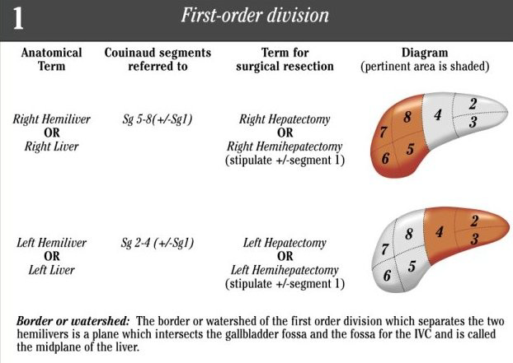
Terminology Committee of the International Hepato-Pancreato-Biliary Association. HPB 2000; 2(3):333-39.

Slide 54
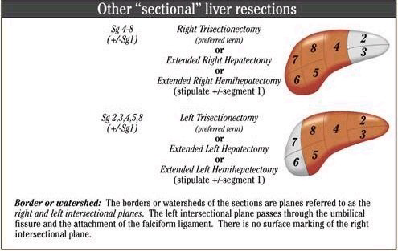
Terminology Committee of the International Hepato-Pancreato-Biliary Association. HPB 2000; 2(3):333-39.

Slide 55
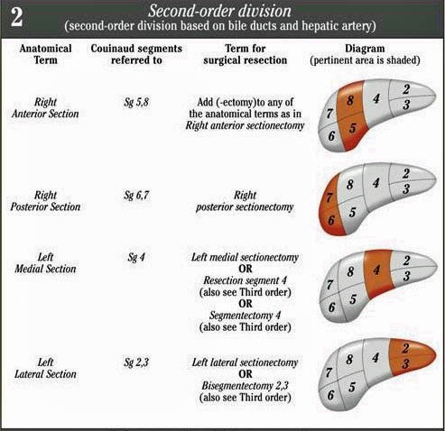
Terminology Committee of the International Hepato-Pancreato-Biliary Association. HPB 2000; 2(3):333-39.

Slide 56
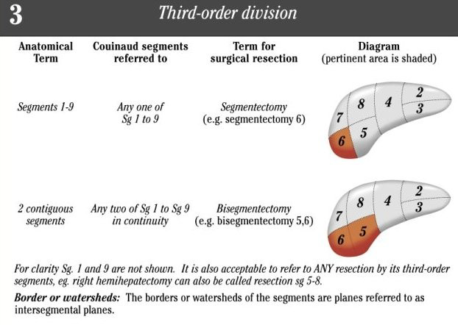

Slide 57
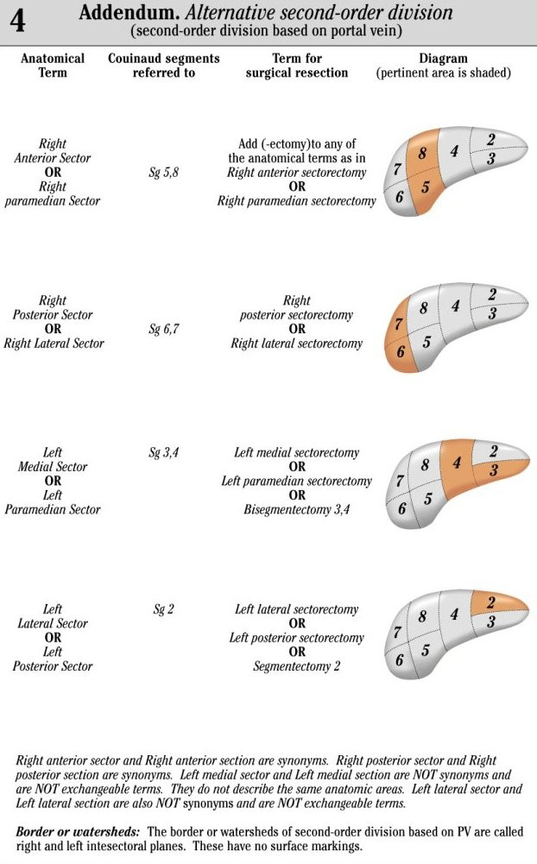

Slide 59
THANK YOU

