Slide 1


Cryptorchidism
PEDIATRIC NECK MASSES
Dr Nitin Sharma
M B B S(Gold medallist), M S(Gen Surgery),
M. Ch. (Paediatric Surgery)(Gold Medallist), AIIMS, New Delhi
FISPU, FMAS

Slide 2
CAUSES
Congenital
Inflammatory
Malignant
Midline
Lateral
Random

Slide 3
Embryology and Anatomy
Branchial System- 6 pairs of pharyngeal arches separated by endodermally lined pouches and ectodermally lined clefts.
Each arch consists of a nerve, artery, and cartilaginous structures.
The remaining neck musculature gains contributions from cervical somites.

Slide 4
Branchial system
First Branchial arch
  Maxillary and mandibular (Meckel’s) process regress to leave the malleus and incus.
  Ossification around Meckel’s cartilage gives rise to the mandible, sphenomandibular ligament, and anterior malleolar ligaments.
  Muscles- temporalis, masseter, pterygoids, mylohyoid, ant belly of digastric, tensor tympani, tensor veli palatini

Slide 5
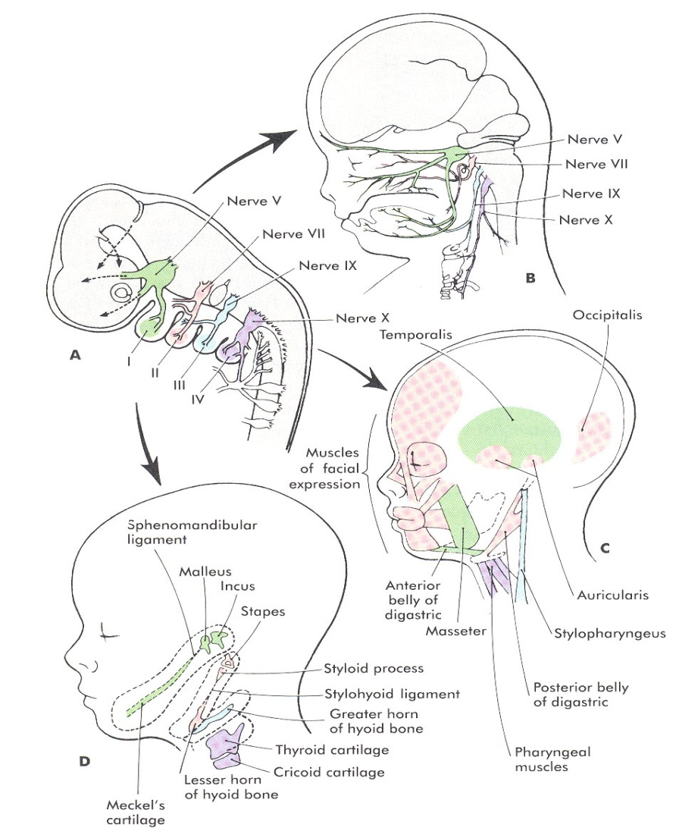
Branchial system
First Branchial Arch
Pouch
  Eust tube, mid ear
  Temporal bone
Cleft
  EAC/TM

Slide 6
Branchial system
Second Branchial Arch
  Reichert’s cartilage contributes to the superstructure of the stapes, the upper body and lesser cornu of the hyoid, the styloid process and stylohyoid ligament.
  Muscles- platysma, muscles of facial expression, posterior belly of digastric, stylohyoid, and stapedius
  Nerve- 7th cranial nerve
  Artery- stapedial artery

Slide 7
Branchial system
Third Branchial Arch
  Lower body of the hyoid and greater cornu.
  Muscles- stylopharyngeus, superior and middle pharyngeal constrictors.
  Nerve- 9th cranial nerve
  Artery- common carotid and proximal portions of the internal and external carotid.

Slide 8
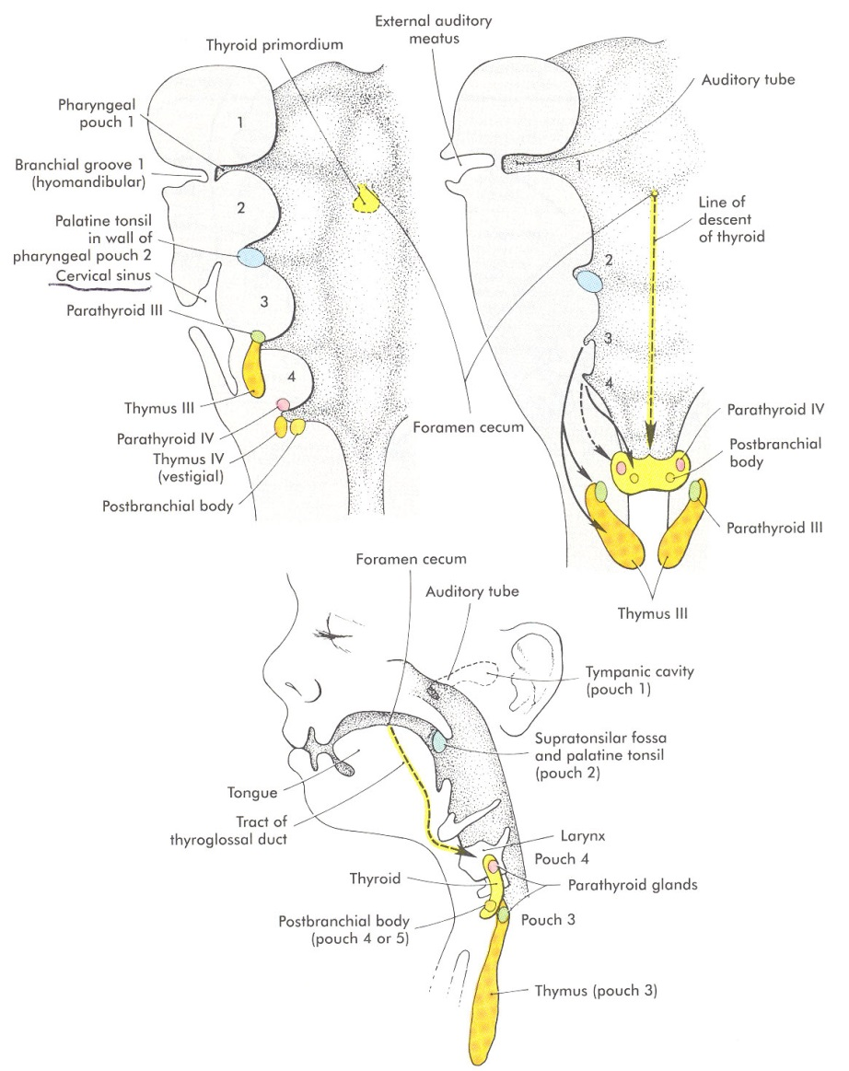
Branchial system
Third Branchial Pouch
  Inferior parathyroids
  Thymus gland and thymic duct

Slide 9
Branchial system
Fourth and Sixth Branchial arches fuse to form the laryngeal cartilages.
Fourth Arch
  Muscles- cricothyroid, inferior pharyngeal constrictors
  Nerve- Superior Laryngeal Nerve
  Artery- Right Subclavian, Aortic arch
Fourth Pouch- superior parathyoid glands and parafollicular thyroid cells

Slide 10
Branchial system
Sixth Branchial Arch
  Muscles- remaining/intrinsic laryngeal musculature
  Nerve- Recurrent Laryngeal Nerve
  Artery- Pulmonary Artery and ductus arteriosus

Slide 11
Branchial system
Epipericardial ridge- mesodermal elements of the sternocleidomastoid, trapezius, and lingual and infrahyoid musculature.
  Nerve- hypoglossal and spinal accessory nerve
Cervical Sinus of His

Slide 12
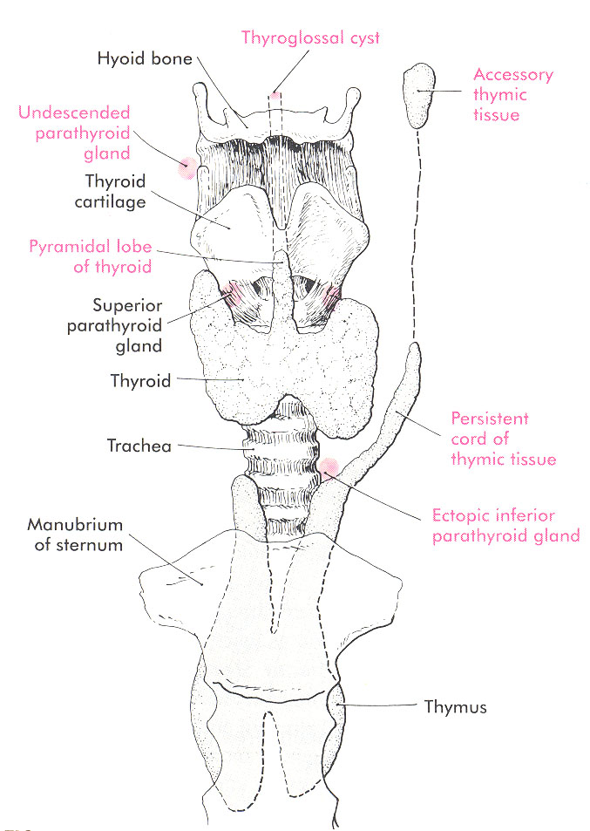
Thyroid Gland
Endoderm of the floor of mouth between the 1st and 2nd archs.
Descends as a bilobed diverticulum from the foramen cecum around the 4th week to rest by the 7-8th week.

Slide 13
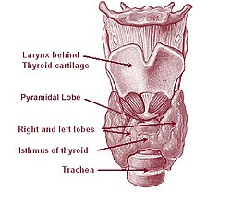
Neck Masses
Midline Neck Masses
  Thyroid nodules
  Cervical Lymphadenopathy
  Thyroglossal Duct cyst
  Thymus gland anomalies
  Plunging ranula
Lateral Neck Masses
  Branchial cleft anomalies
  Laryngoceles
  Dermoid and Teratoid Cysts
  Lymphangioma and Hemangioma

Slide 14
Midline Neck Masses
Thyroid nodules
Thyroglossal duct cyst
Cervical Thymic Cyst
Plunging ranula

Slide 15
Thyroglossal Duct Cyst
Most common congenital midline mass
Asymptomatic mass at or below the hyoid bone that elevates with tongue protrusion.
Ectopic thyroid tissue vs. thyroglossal duct cyst?

Slide 16
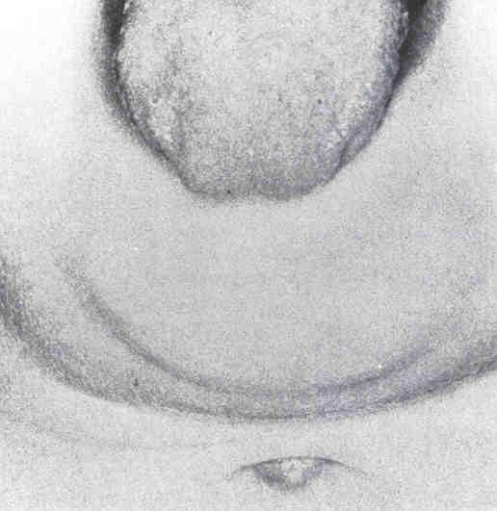
Thyroglossal Duct Cyst

Slide 17
Thyroglossal Duct Cyst
1-2% have Ectopic Thyroid glands so imaging is indicated to document presence of a normal or ectopic thyroid gland
Simple Excision leads to high recurrence rate
Sistrunk Procedure
Patients at high risk for recurrence- Modified Sistrunk Procedure

Slide 18
Cervical Thymic Cysts
Failure of involution of the cervical thymopharyngeal ducts.
Firm, mobile masses found in the lower aspects of the neck.
CXR, CT scan
Surgical Excision- Inferior limit of dissection is the brachiocephalic v.

Slide 19
Plunging Ranula
Simple ranula- unilateral oral cavity cystic lesion.
Plunging ranula- pierce the mylohyoid to present as a paramedian or lateral neck mass.
Cyst aspirate- high protein, amylase levels
CT scan/MRI
Treatment is intraoral excision to include the sublingual gland of origin.

Slide 20
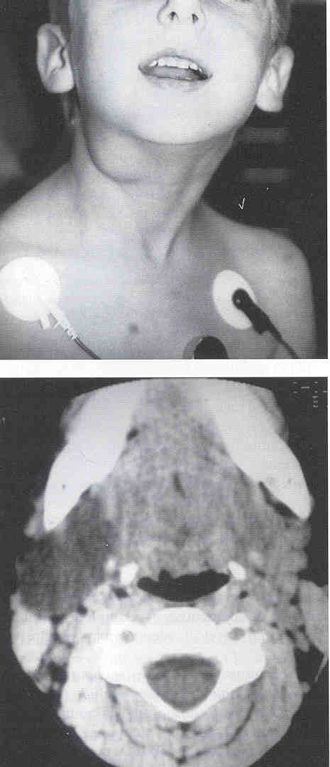
Plunging Ranula

Slide 21
Lateral Neck Masses
Branchial cleft anomalies
Laryngoceles
Dermoid and Teratoid Cysts
Sternocleidomastoid Pseudotumor of Infancy
Lymphangiomas and hemangiomas

Slide 22
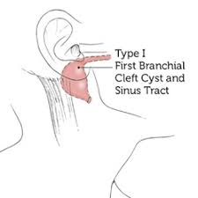
First Branchial Cleft Cysts
Type I
  Ectodermal Duplication anomaly of the EAC with squamous epithelium only.
  Parallel to the EAC
  Pretragal, post auricular
  Connection with TM or Malleus>Incus
  Surgical Excision

Slide 23
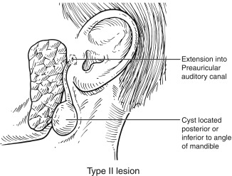
First Branchial Cleft Cysts
Type II
  Squamous epithelium and other ectodermal components
  Anterior neck, superior to hyoid bone.
  Courses over the mandible and through the parotid in variable position to the Facial Nerve.
  Terminates near the EAC bony-cartilaginous junction.
  Surgical excision- superficial parotidectomy

Slide 24
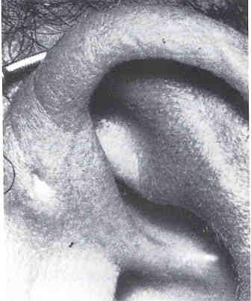
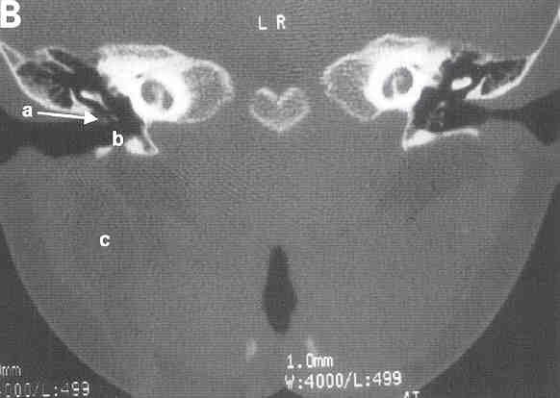
First Branchial Cleft Cysts

Slide 25
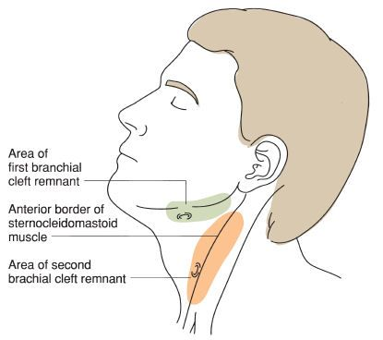
Second Branchial Cleft Cysts
Most Common (90%) branchial anomaly
Painless, fluctuant mass in anterior triangle
Inferior-middle 2/3 junction of SCM, deep to platysma, lateral to IX, X, XII, between the internal and external carotid and terminate in the tonsillar fossa
Surgical treatment: Excision

Slide 26
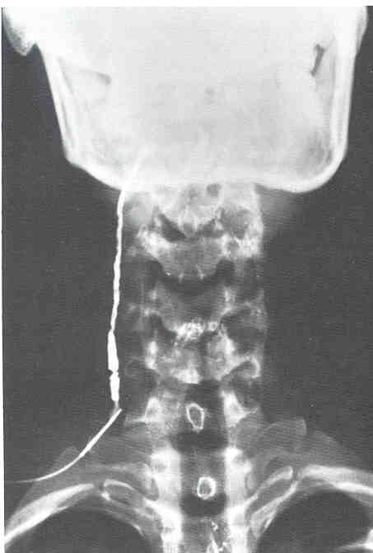
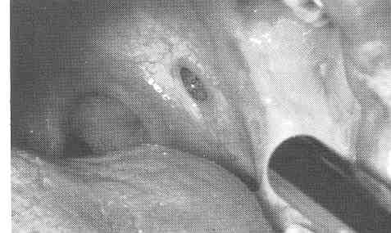
Second Branchial Cleft Cysts

Slide 27
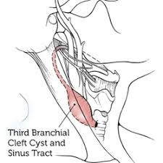
Third Branchial Cleft Cysts
Rare (<2%)
Similar external presentation to 2nd BCC
Internal opening is at the pyriform sinus, then courses cephalad to the superior laryngeal nerve through the thyrohyoid membrane, medial to IX, lateral to X, XII, posterior to internal carotid
Surgical approach must visualize recurrent layngeal nerves- Thyoidectomy incision

Slide 28
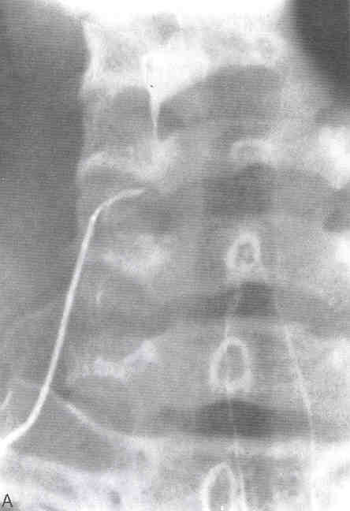
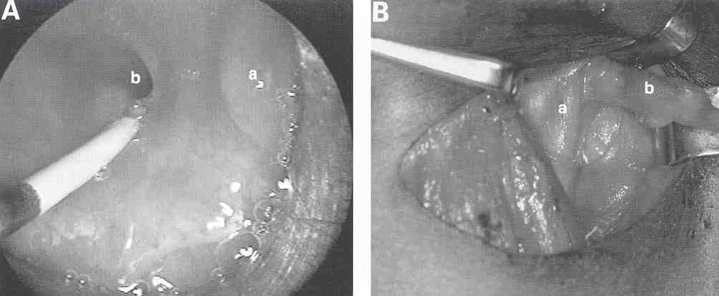
Third Branchial Cleft Cysts

Slide 29
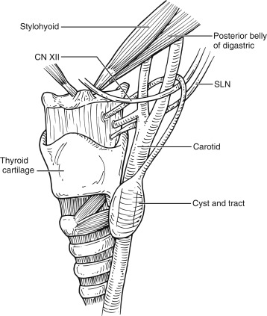
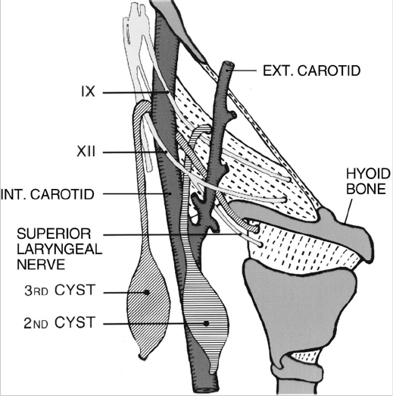
Second and third cleft cyst

Slide 30
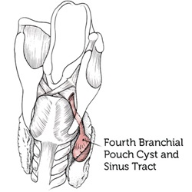
Fourth Branchial Cleft Cysts
Courses from pyriform sinus apex caudal to superior laryngeal nerve, to emerge near the cricothryoid joint, and descend superficial to the recurrent laryngeal nerve.

Slide 31
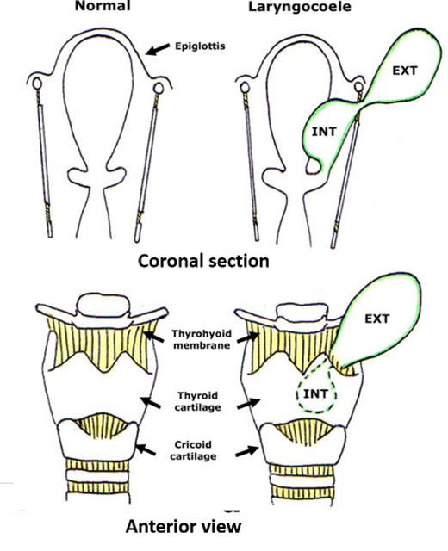
Laryngoceles
Congenitally from an enlarged laryngeal saccule.
Classified as internal, external, or both
Internal
  Confined to larynx, usually involves the false cord and aryepiglottic fold.
  Hoarseness and respiratory distress vs. neck mass.

Slide 32
Laryngoceles
External and Combined Laryngoceles
  Soft, compressible, lateral neck mass that distends with increases in intralaryngeal pressures.
  Through the thyrohyoid membrane at the entrance of the Superior Laryngeal Nerve.
  CT scan
  Asymptomatic vs Symptomatic laryngoceles.

Slide 33
Laryngoceles
1-3% of Laryngoceles will harbor an underlying laryngeal carcinoma
ALL adult patients should undergo direct laryngoscopy at the time of surgical intervention.
Tx:
  internal → endoscopic marsupialization
  External or combined → external approach

Slide 34
Dermoid and Teratoid Cysts
Developmental anomalies composed of different germ cell layers.
Isolation of pluripotent stem cells or closure of germ cell layers within points of failed embryonic fusion lines.
Classified according to composition.

Slide 35
Dermoid Cysts
Mesoderm and Ectoderm
Midline, paramedian, painless masses that usually do not elevate with tongue protrusion.
Commonly misdiagnosed as Thyroglossal Duct Cysts.
Treatment is simple surgical excision

Slide 36
Teratoid Cysts and Teratomas
All three germ cell layers- Endoderm, mesoderm and ectoderm.
Larger midline masses, present earlier in life.
20% associated maternal polyhydramnios
Unlike adult teratomas, they rarely demonstrate malignant degeneration.
Surgical excision.

Slide 37
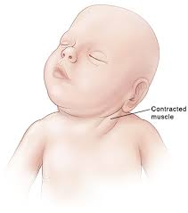
Sternomastoid Tumor of Infancy
(Psuedotumor)
Firm mass of the SCM, chin turned away and head tilted toward the mass.
Hematoma with subsequent fibrotic replacement.
Ultrasound
Physical therapy is very successful.
Myoplasty of the SCM only if refractory to PT.

Slide 38
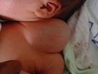
CYSTIC HYGROMA
Lymphatic malformation
Presentation:
  Variable size masses in neck or shoulder region
  Soft cystic, transilluminant
  Dystocia
  Rarely respiratory distress
Externally Visible: Spot diagnoses

Slide 39

CYSTIC HYGROMA
Dos:
  Rarely require airway support if causing distress
  Investigate
    CT / MRI
Treatment
  Surgical excision
  Sclerotherapy
Externally Visible: Spot diagnoses

Slide 40
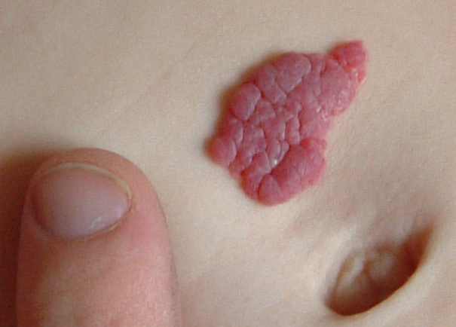
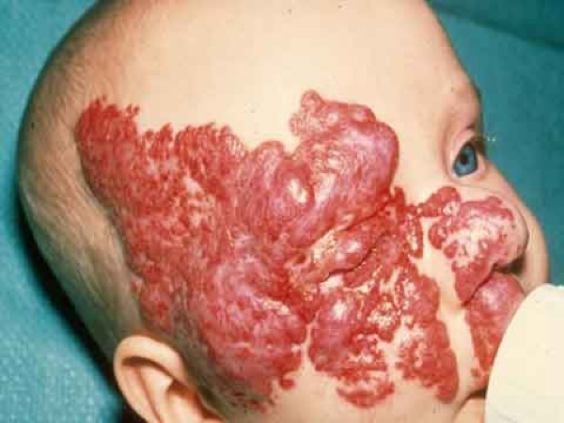
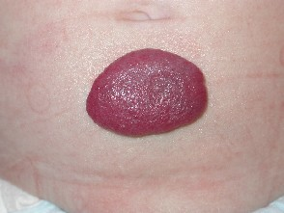
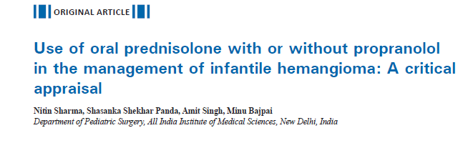
HEMANGIOMAs
Do not require any urgent management
Reassure the parents
Externally Visible: Spot diagnoses

Slide 41
Conclusions
Neck masses are very common
Approach with History and Physical exam will commonly lead to the correct diagnosis
An understanding of cervical embryology is crucial in treatment of these masses

Slide 42
THANKS

