Slide 1


Cryptorchidism
PEDIATRIC GERM CELL TUMOURS
Dr Nitin Sharma
M B B S(Gold medallist), M S(Gen Surgery),
M. Ch. (Paediatric Surgery)(Gold Medallist), AIIMS, New Delhi
FISPU, FMAS

Slide 2
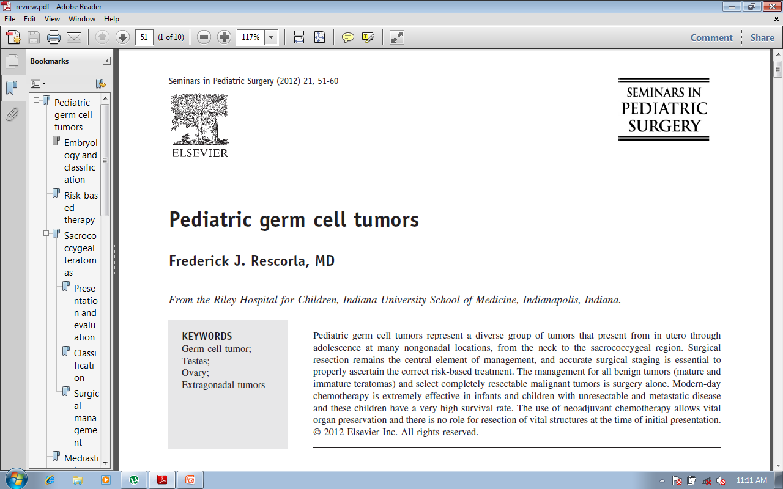

Slide 3
GERM CELL TUMOURS
GONADAL
EXTRA GONADAL
TESTICULAR
OVARIAN
  SACROCOCCYGEAL TERATOMAS
  MEDIASTINAL GERM CELL TUMORS
  ABDOMINAL AND RETROPERITONEAL
  GERM CELL TUMOR
  GENITAL GERM CELL TUMORS
  CERVICOFACIAL TERATOMAS
  GASTRIC TERATOMAS

Slide 4
Pediatric germ cell tumors represent only 1-3% of childhood tumors
Approximately 20% of these are malignant, although the rate of malignancy varies by age and location
Extragonadal sites account for 50% of tumors compared with adults, whereas only 10% are Extragonadal

Slide 5
Most common malignant histology is yolk sac tumor[endodermal sinus tumor]
Alpha fetoprotein (AFP) serves as marker for disease.
It is common at the
  Sacrococcygeal
  Retroperitoneal
  Mediastinal,
  Prepubertal testes locations

Slide 6
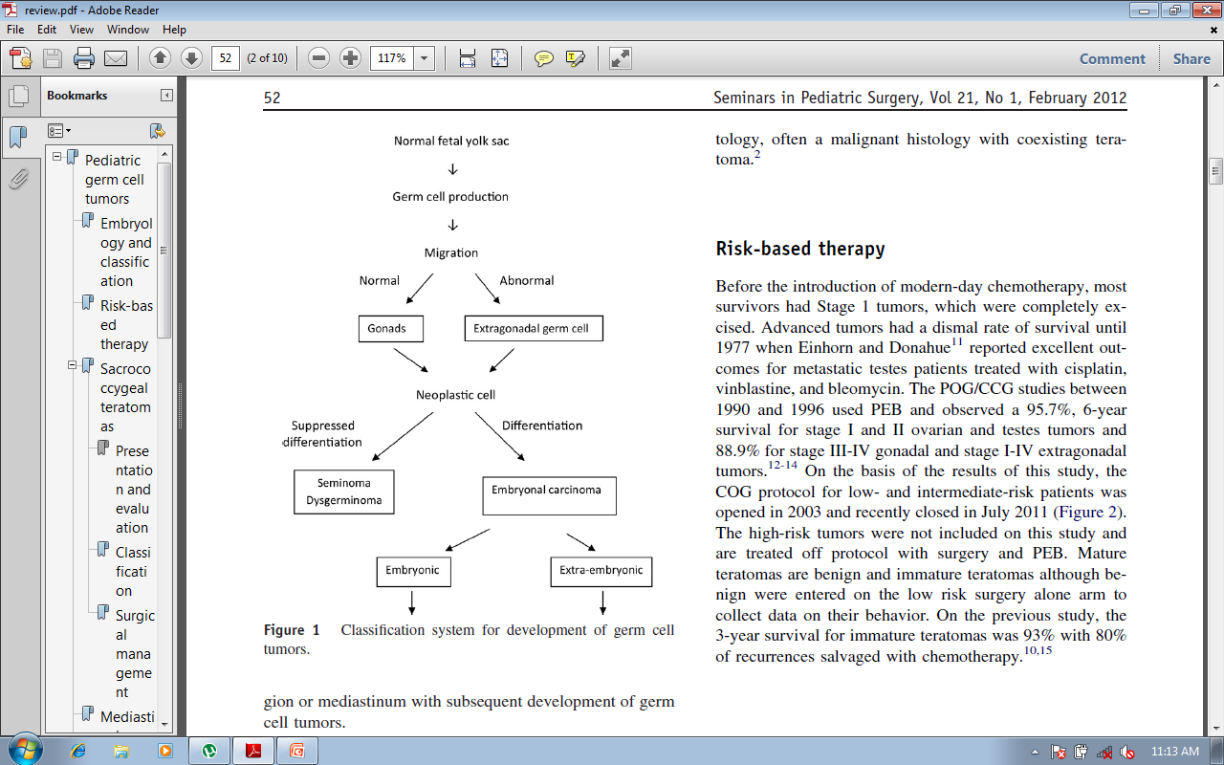

Slide 7
Advanced tumors had a dismal rate of survival until 1977.
Einhorn and Donahue reported excellent outcomes for metastatic testes patients treated with cisplatin, vinblastine, and bleomycin.
POG/CCG studies between 1990 and 1996 used PEB and observed a 95.7%, 6-year survival for stage I and II ovarian and testes tumors and 88.9% for stage III-IV gonadal and stage I-IV extragonadal tumors
The 3-year survival for immature teratomas was 93% with 80% of recurrences salvaged with chemotherapy

Slide 8
GERM CELL TUMOUR
CLINICAL EVALUATION
TUMOUR MARKER
(AFP)
IMAGING

Slide 9
GERM CELL TUMOUR
RESECTABLE
NON RESECTABLE
METASTATIC
VERY HIGH AFP LEVEL
EXTENSIVE LESION
POOR GENERAL CONDITION
SURGICAL EXCISION
BEP CHEMOTHERAPY

Slide 10
BEP Regiemn
Inj. Cis-platinum: 35 mg/m²/day, Day 1 to 3 (IV infusion over 1 hr.)
Inj. Etoposide(VP-16): 120 mg/m²/day, Day 1 to 3 (IV infusion over 1 hr.)
Inj. Bleomycin: 15 mg/m² Day 1 to 3 (IV infusion over 1 hr)
IV infusion(IVF): 125 mL/m²/hr, N/2 saline in 5% dextrose + 1mL/100mL KCL

Slide 11
BEP Regiemn
Hematinics and multivitamin syrup.
Syrup Septran: 5mg/kg of trimethopirm/day in two divided doses for three consecutive days every week for upto 6 months after completion of all therapy.
DURATION : Cycles at 3 weekly interval (day 1- day1).
Total of 3 courses for Gonadal and 6 for extragonadal (in these the last two courses omit Bleomycin)

Slide 12
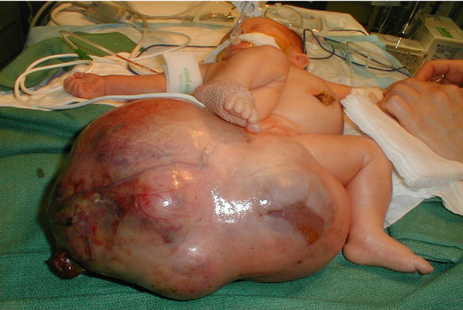
Sacrococcygeal teratomas
1:35,000 live births
most common germ cell tumor in newborns and infants
clinical patterns:
  Large,predominantly external lesions[detected prenatally or at delivery]rarely malignant.
  Older infants present with less apparent pelvic tumors with a very high rate of malignancy

Slide 13
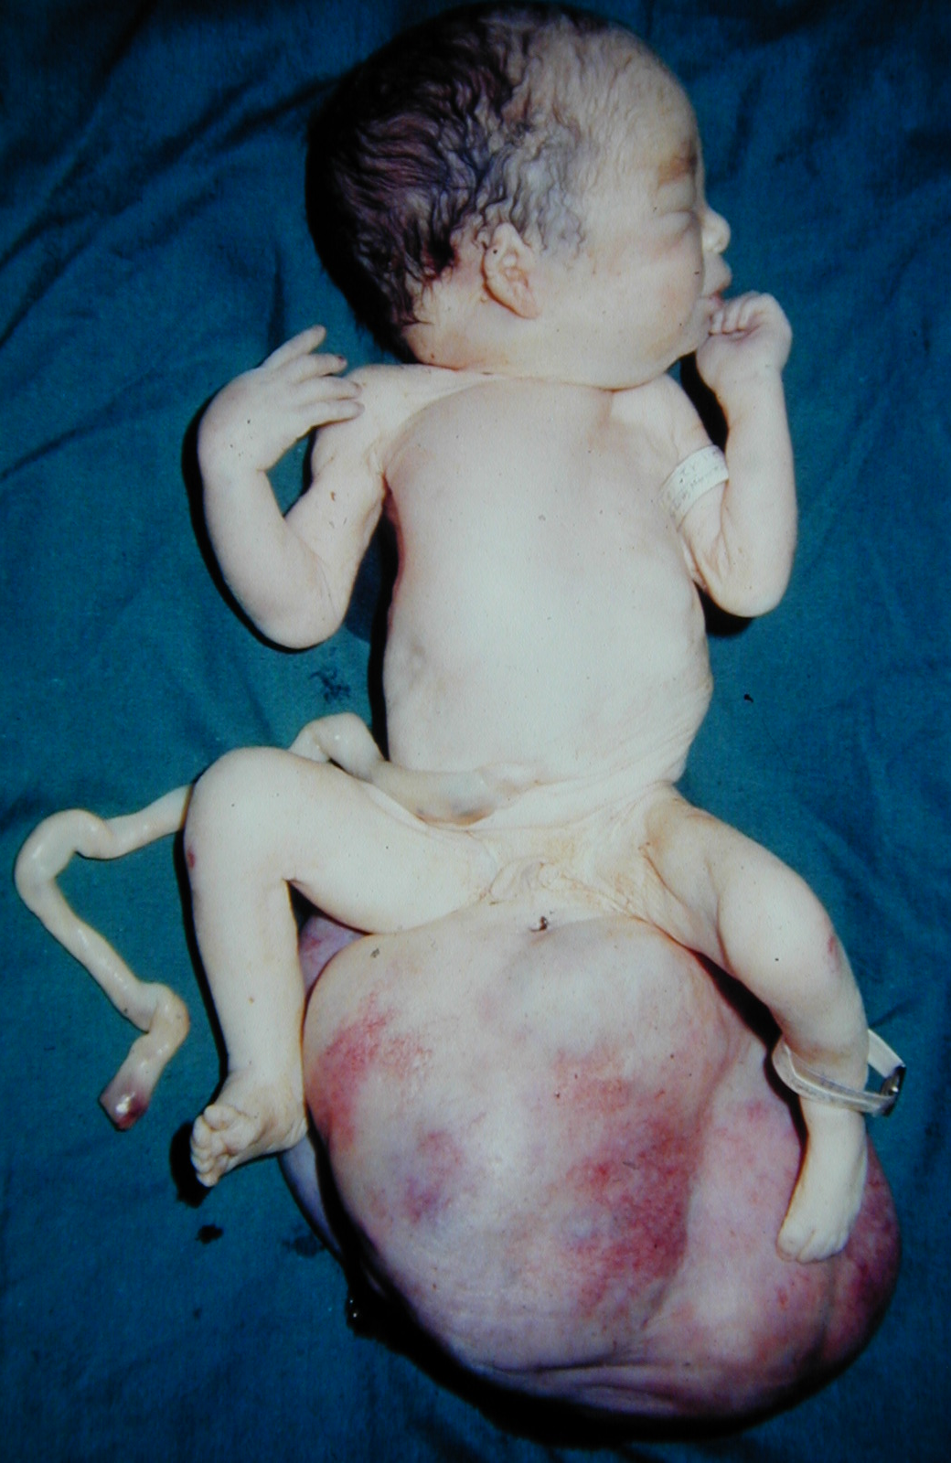
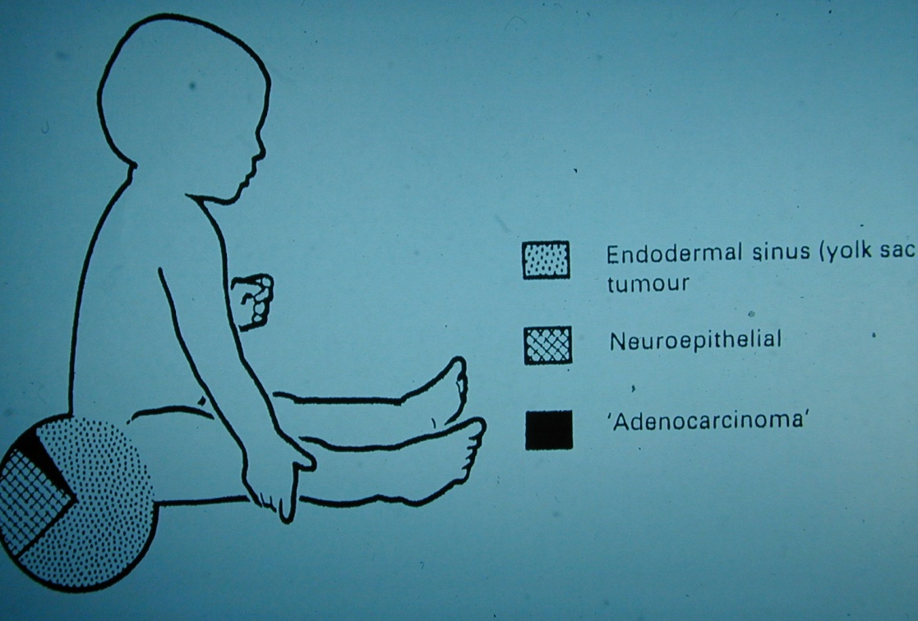
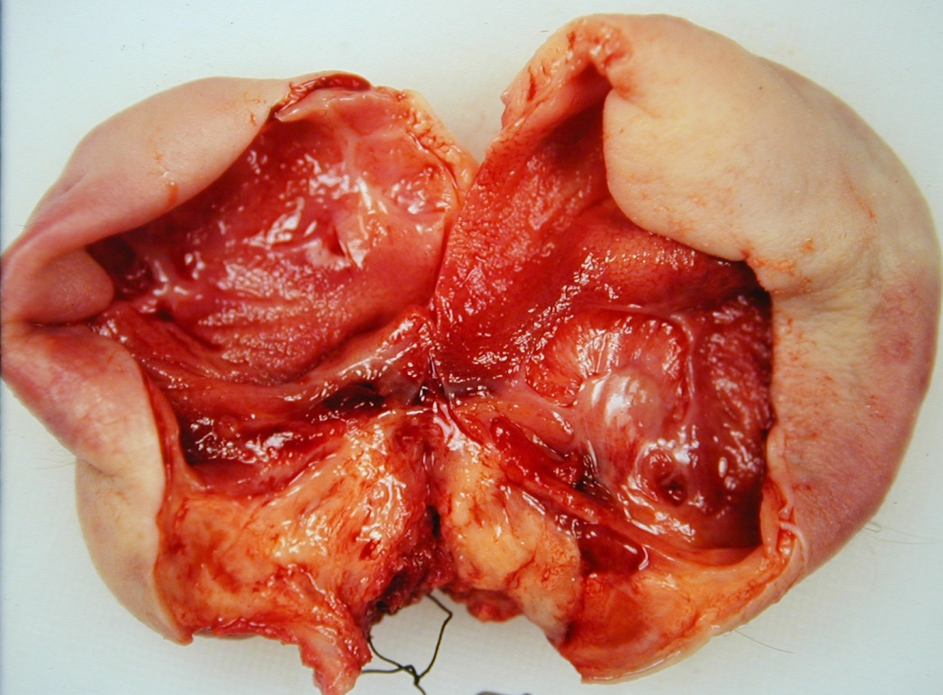

Slide 14
SACRO
COCCYGEAL
TERATOMA
IS A TUMOR MADE UP OF SEVERAL DIFFERENT TYPES OF TISSUE, SUCH AS HAIR, MUSCLE, OR BONE

Slide 15
TERATOMA
SOLID OR CYSTIC
MATURE OR IMMATURE

Slide 16
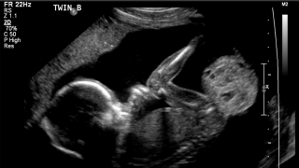
Clinical presentations
In utero
After birth
At older ages

Slide 17
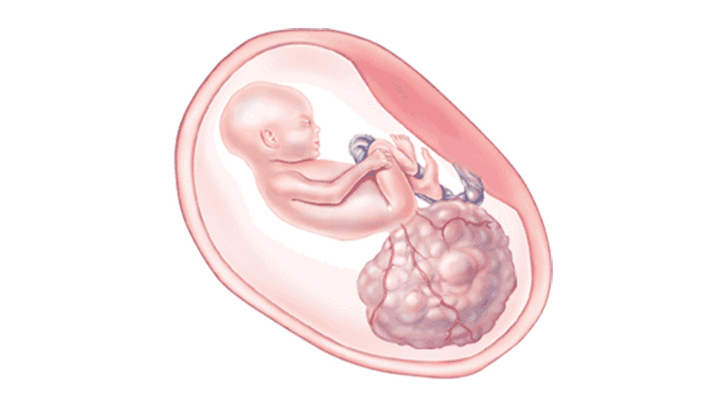
In utero
  Polyhydramnios
  Shunting with high output cardiac failure,
  Hydrops

Slide 18
Recent recommendations*
Less than 28 weeks gestation
  fetal resection for high-output cardiac failure .
Between 28 and 36 weeks
  consideration of an ex utero intrapartum therapy (EXIT) procedure
After 28 weeks with active labor, maternal mirror syndrome or placentomegaly
  Emergency Cesarean delivery is recommended
*Adzick NS, Crombleholme TM, Morgan MA, et al. A rapidly growing fetal teratoma. Lancet 1997;349:538-9.

Slide 19
Older infant
  usually present with symptoms related to bladder or rectal displacement, often with very large pelvic masses.
Currarino triad*-
  Association of presacral teratoma
  Anal stenosis
  Sacral defects
  Autosomal-dominant condition
*Ashcraft KW, Holder TM. Hereditary presacral teratoma. J Pediatr Surg 1974;9:691-7.

Slide 20
Work up
Ultrasound,
computed tomography(CT)
Magnetic resonance imaging (MRI)
Evaluation of the chest for metastatic disease
AFP levels*
*Tsuchida Y, Endo Y, Saito S, et al. Evaluation of alpha-fetoprotein in early infancy. J Pediatr Surg 1978;13:155-6.

Slide 21
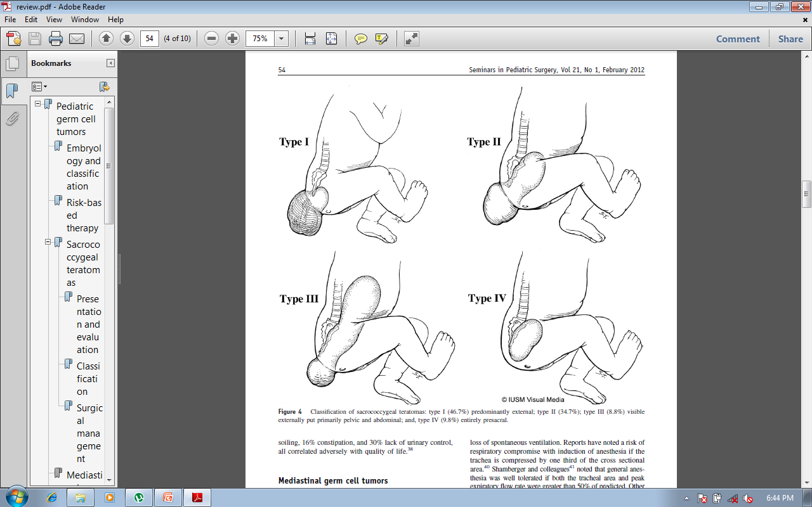

Slide 22
Malignancy rate
Greater in the less-apparent lesions (types III and IV) *
<2 months of age 7% girls and 10% boys malignant *
>2 months, 48% girls and 67% boys malignant *
Malignancy rate in older infants up to 90% * *
* Altman RP, Randolph JG, Lilly JR. Sacrococcygeal teratoma: American Academy of Pediatrics Surgical Section Survey –1973. J Pediatr Surg 1974;9:389-98
* * Rescorla FJ, Sawin RS, Coran AG, et al. Long-term outcome for infants and children with sacrococcygeal teratoma: A report from the children’s Cancer Group. J Pediatr Surg 1998;33:171-6.

Slide 23
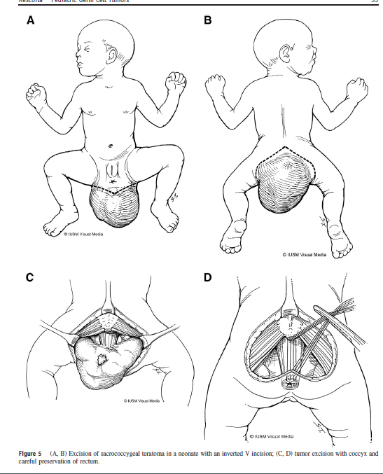
Surgical management and outcome
-Prone position
-V shaped incision
-Removal of the coccyx *
-Ligation of the middle sacral artery
-A buttocks-contouring closure * *

Slide 24
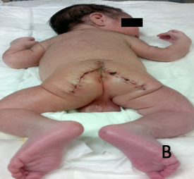
Surgical management and outcome
Prone position
V shaped incision
Removal of the coccyx *
Ligation of the middle sacral artery
A buttocks-contouring closure * *
* Gross RW, Clatworthy HW, Meeker IA. Sacrococcygeal teratoma in infants and children: A report of 40 cases. Surg Gynecol Obstet 1951;92:341-54.
* * Fishman SJ, Jennings RW, Johnson SM, et al. Contouring buttock reconstruction after sacrococcygeal teratoma resection. J Pediatr Surg 2004;39:439-41

Slide 25
CCG/POG intergroup study *
74 infants with malignant sacrococcygeal tumors (all yolk sac histology), [[62 girls and 12 boys] (median age 21 months)]
59% presented with metastatic disease
29 had initial resection, and 45 had biopsy and neoadjuvant chemotherapy
All infants and children chemotherapy with PEB
overall 4-year event-free survival (EFS) was 84+/- 6% and overall survival (OS) 90+/-4% with no difference between timing of resection or presence of metastatic disease
This evidence provides strong support to the principle of avoiding initial resection with the sacrifice of vital structures and instead initial using biopsy and neoadjuvant therapy followed by resection
* Rescorla F, Billmire D, Stolar C, et al. The effect of cisplatin dose and surgical resection in children with malignant germ cell tumors at the sacrococcygeal region: A pediatric intergroup trial (POG 9049/CCG 8882). J Pediatr Surg 2001;36:12-7.

Slide 26
Neonatal tumors(SCT) *
Most neonatal tumors are mature or immature teratomas are treated with surgery and observation.
Follow-up should include serial AFP levels every 2-3 months to ensure return to normal by 9 months and rectal examination every 3 months until age 3 years to evaluate for recurrence.
Recurrent tumors are observed in 10%-20% of initially benign tumors and 50% of these are malignant
* Bilik R, Shandling B, Pope M, et al. Malignant benign neonatal sacrococcygeal teratoma. J Pediatr Surg 1993;28:1158-60.

Slide 27
Long-term sequelae
Neuropathic bladder or bowel abnormalities, have been observed in 11%-41% of survivors *
Poor quality of life * *
  9% of the children had involuntary bowel movements,
  13% soiling
  16% constipation
  30% lack of urinary control
* Mann JR, Gray ES, Thornton C, et al. Mature and immature extracranial teratomas in children: The UK children’s Cancer Study Group experience. J Clin Oncol 2008;26:3590-7.
* * Derikx JP, De Backer A, van de Schoot L, et al. Long-term functional sequelae of sacrococcygeal teratoma: A national study in the Netherlands. J Pediatr Surg 2007;42:1122-6

Slide 28
Mediastinal germ cell tumors
Usually located in the anterior mediastinum
Symptoms-
  respiratory distress
in adolescence
  chest pain,
  Precocious puberty
  facial fullness
  vascular congestion

Slide 29
yolk sac is the predominant histology in girls as well as younger boys,
whereas older boys had mixed histology in over 50%
* Billmire D, Vinocur C, Rescorla F, et al. Malignant mediastinal germ cell tumors: An intergroup study. J Pediatr Surg 2001;36:18-24.

Slide 30
Anesthetic risks
Airway compression
Respiratory compromise with induction of anesthesia if the trachea is compressed by one third of the cross sectional area. *
General anesthesia was well tolerated if both the tracheal area and peak expiratory flow rate were greater than 50% of predicted * *
* Azizkhan RG, Dudgeon DL, Buck JR, et al. Life-threatening airway obstruction as a complication to the management of mediastinal masses in children. J Pediatr Surg 1985;20:816-22
* * Shamberger RC, Holzman RS, Griscom NT, et al. CT quantitation of tracheal cross-sectional area as a guide to the surgical and anesthetic management of children with anterior mediastinal masses. J Pediatr Surg 1991;26:138-43

Slide 31
Outcome and overall survival *
overall survival was 71%, which is lower than the other extragonadal sites
38 children, 14 were amenable to initial resection
Remainder underwent biopsy, followed by neoadjuvant therapy.
The mass was reduced by 57% in two-thirds and stable or increased in the other third.
Median sternotomy and thoracotomy were both used for resection.
Post chemotherapy residual disease must be resected as persistent germ cell tumor may be present, even if markers are normal as mixed histology tumors are common
* Billmire D, Vinocur C, Rescorla F, et al. Malignant mediastinal germ cell tumors: An intergroup study. J Pediatr Surg 2001;36:18-24

Slide 32
Abdominal and retroperitoneal germ cell tumors
present in infancy with *
  a mass
  pain as the common symptoms
  weight loss,
  constipation
  acute abdomen also occur.
Mature and immature teratomas dominate with malignancy rates up to 24% *.
* Luo CC, Huang CS, Chu SM, et al. Retroperitoneal teratomas in infancy and childhood. Pediatr Surg Int 2005;21:536-40.

Slide 33
Most frequent malignant histology is yolk sac (63%)
But choriocarcinoma and mixed tumors also occur
Billmire D, Vinocur C, Rescorla F, et al. Malignant retroperitoneal and abdominal germ cell tumors: An intergroup study. J Pediatr Surg 2003;38:315-8.

Slide 34
Primary resection is the preferred initial treatment if preoperative imaging suggests lack of vital organ involvement or metastatic disease

Slide 35
Only 5 of 25 patients had primary resection with the remainder receiving initial chemotherapy followed by complete or partial resection.
Four had no post chemotherapy residual mass.
Survival was excellent with a 6-year EFS of 82+/- 10.9% and OS of 87.9 +/- 9.3%
Billmire D, Vinocur C, Rescorla F, et al. Malignant retroperitoneal and abdominal germ cell tumors: An intergroup study. J Pediatr Surg 2003;38:315-8

Slide 36
Growing teratoma *
Enlargement of benign elements of a tumor, such as mature or immature teratomas, referred to as the “growing teratoma syndrome.”
Proper management is initial resection without administration of chemotherapy
* Logothetis CJ, Samuels ML, Trinidale A, et al. The growing teratoma syndrome. Cancer 1982;50:1629-35.

Slide 37
Genital germ cell tumors *
Genital lesions are primarily vaginal
The current survival is greater than 90%.
Most patients present with vaginal bleeding and are noted with a protruding mass.
There is no role for initial vaginal resection
Initial biopsy followed by chemotherapy allows ultimate vaginal preservation in more than 80% of girls
* Rescorla F, Billmire D, Vinocur C, et al. The effect of neoadjuvant chemotherapy and surgery in children with malignant germ cell tumors of the genital region: A pediatric intergroup trial. J Pediatr Surg 2003;38:910-2.

Slide 38
Cervicofacial teratomas *
Most lesions at this site present in the neonatal period
Nearly all are mature or immature teratomas.
Approximately one-third present with airway obstruction.
Giant fetal tumors have been noted with hydrops leading to fetal demise as well as successful fetal resection.
In those without hydrops, an EXIT procedure is appropriate.
If hydrops develops at less than 28-weeks gestation, fetal resection should be considered.
* Hirose S, Sydorak RM, Tsao K, et al. Spectrum of intrapartum management strategies for giant fetal cervical teratoma. J Pediatr Surg 2003;38:446-50

Slide 39
Gastric teratomas
Tumors at this site are rare
Can develop symptoms of gastric outlet obstruction as a cystic component enlarges.
There are no reported malignancies
Primary resection is the procedure of choice.

Slide 40
GONADAL GERM CELL TUMOUR

Slide 41
Testicular Germ cell tumour
Testes germ cell tumors are rare, with a small peak in the first3 years of life and a larger peak in adolescence.
The malignant tumors in the younger boys are primarily yolk sac tumors
Whereas the older boys have seminomas and mixed tumors.
In the young boys other tumors, such as Sertoli tumors and paratesticular rhabdomyosarcomas are more common than germ cell tumors.
In the adolescent years, germ cell tumors are the primary cause of a testicular mass

Slide 42
Most present as a painless mass, but in some a hydrocele or hernia may lead to the diagnosis
Ultrasound is the preferred imaging modality
The exact incidence of malignancy in prepubertal testes masses is not known,
In one series 74% were benign with 48% teratomas and only 5% were yolk sac tumors *
AFP is elevated in nearly all prepubertal malignant testes tumors *
* Schneider D, Calaminus G, Koch S, et al. Epidemiologic analysis of 1,442 children and adolescents registered in the German germ cell tumor protocols. Pediatr Blood Cancer 2004;43:169-75

Slide 43
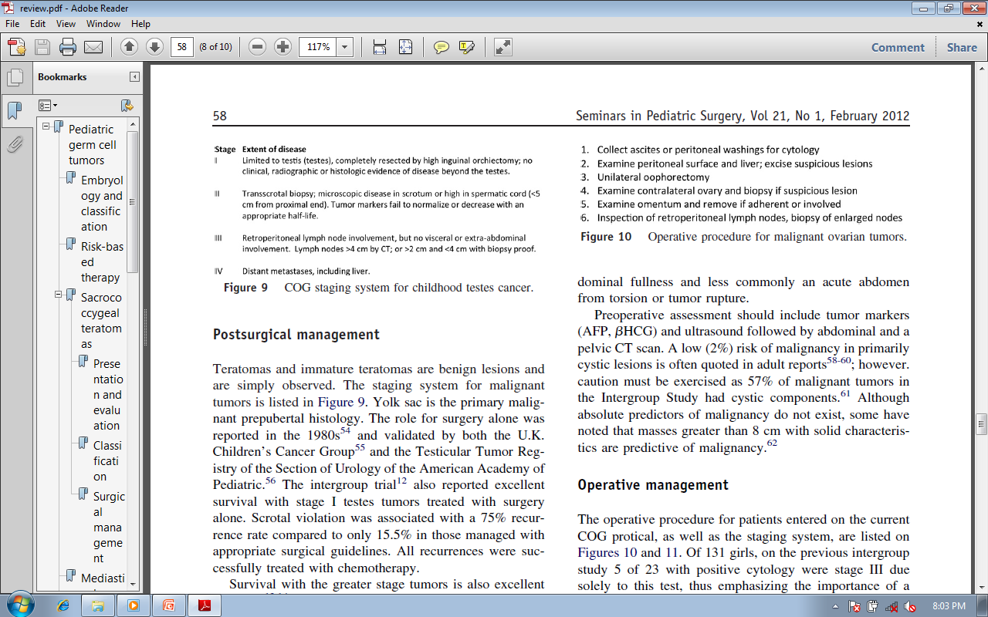

Slide 44
Surgical Management
An elevated AFP indicates malignant histology and precludes consideration of testes sparing surgery, high ing orchidectomy done.
If the AFP is normal, consideration should be given to a benign lesion and the tunica opened, and if amenable, enucleation of the mass performed.

Slide 45
Postsurgical management
Teratomas and immature teratomas are benign lesions and are simply observed
Scrotal violation is associated with a 75% recurrence rate compared to only 15.5% in those managed with appropriate surgical guidelines. All recurrences are successfully treated with chemotherapy *.
Survival with the greater stage tumors is excellent with surgery and chemotherapy.
* Schlatter M, Rescorla F, Giller R, et al. Excellent outcome in patients with stage I germ cell tumors of the testes: A study of the children’s Cancer group/Pediatric Oncology Group. J Pediatr Surg 2003;38:319-24.

Slide 46
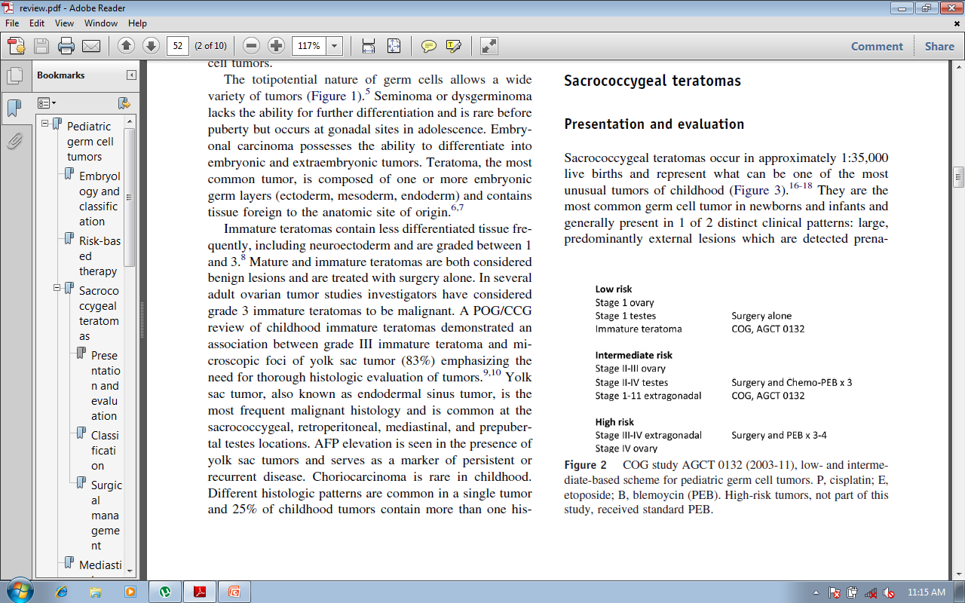

Slide 47
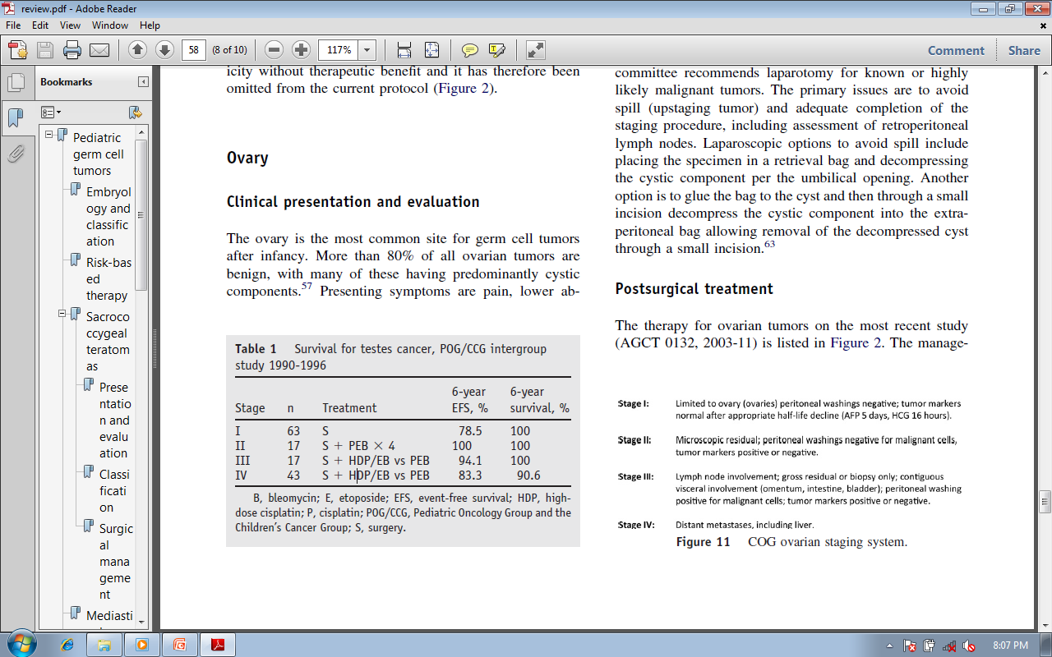

Slide 48
Germ Cell Tumours of Ovary
The ovary is the most common site for germ cell tumors after infancy.
More than 80% of all ovarian tumors are benign, with many of these having predominantly cystic components.
Presenting symptoms are
  Pain
  lower abdominal fullness
  less commonly an acute abdomen from torsion or tumor rupture

Slide 49
Preoperative assessment include
  tumor markers(AFP, HCG)
  ultrasound
  abdominal and a pelvic CT scan

Slide 50
Malignancy risk
A low (2%) risk of malignancy in primarily cystic lesions is often quoted in adult reports
However caution must be exercised as 57% of malignant tumors in the Intergroup Study had cystic components *
Masses greater than 8 cm with solid characteristics are predictive of malignancy *
* Oltmann SC, Garcia N, Barber R, et al. Can we preoperatively risk stratify ovarian masses for malignancy? J Pediatr Surg 2010;45:130-4.

Slide 51
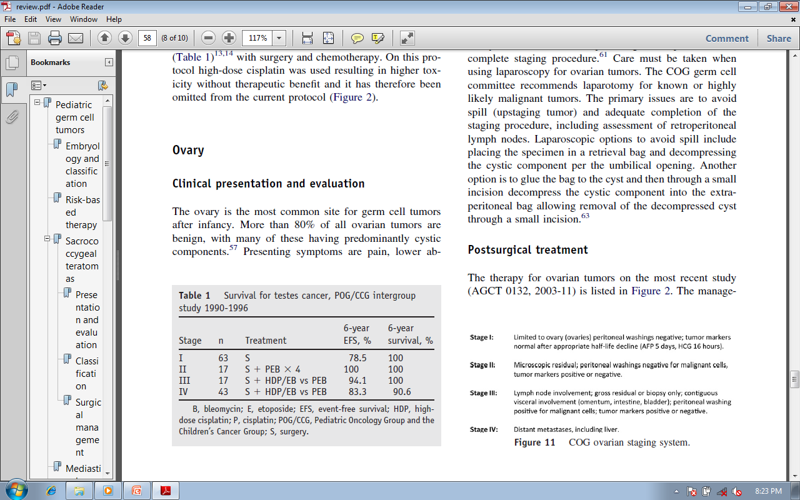
COG Ovarian Staging system

Slide 53
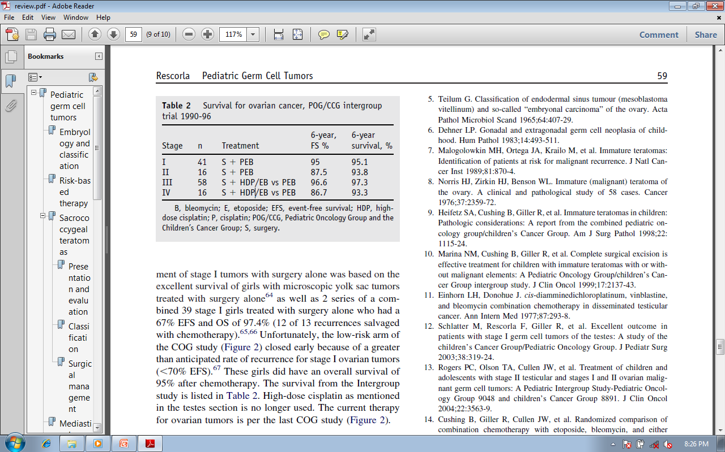

Slide 54
Conclusions
Pediatric germ cell tumors are a heterogeneous group of tumors based on histology, age at presentation, tumor location and outcome.
Surgical resection remains the primary means of diagnosis and management.
Initial surgical resection without loss of vital structures is the initial treatment.
Benign (immature and mature teratomas) and select completely resected malignant tumors are managed with neoadjuvant chemotherapy and delayed surgical resection
The outcome of these children as well as those with metastatic disease is excellent with modern chemotherapy.

Slide 55
THANKS

